Slide 1
Able to develop the real time scenarios based on NodeJS applications.
Notes:
Title - The learning outcome
Subtitle - Duration

Slide 2
In this section, we will discuss:
Introduction to mean stack
Introduction to Angular JS and UI benefits in Angular JS
Usage of Angular JS with HTML
Event Handling in Angular JS
Introduction Angular & difference b/w angular-1 to angular-5
Notes:
Mention the parent topics one by one. This particular learning outcome has 5 parent topics.

Slide 3
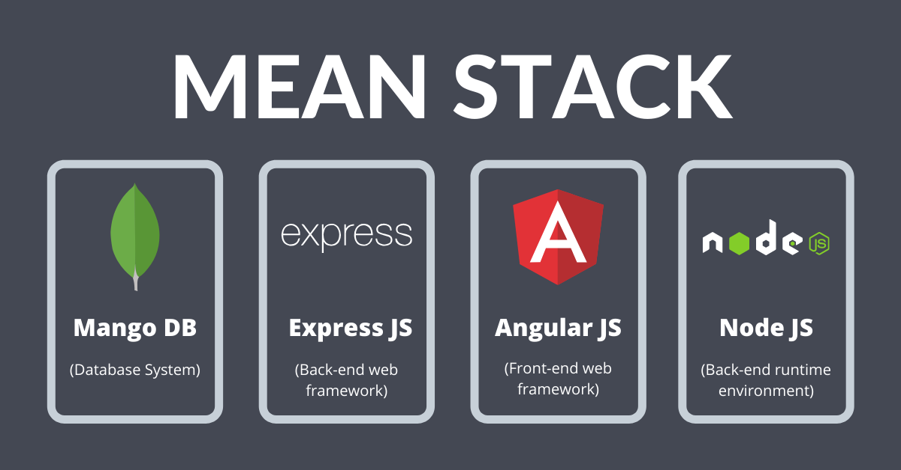
Introduction to mean stack
MEAN Stack
The MEAN stack is JavaScript-based framework for developing web applications
MEAN is comprised of four different technologies:
MongoDB
Express JS
AngularJS
Node.js
Image Source: https://www.thirdrocktechkno.com/blog/what-is-mean-stack-mean-stack-components-and-benefits/
Notes:
Left (White Color space):
Title - Parent Topic
Subtitle - Subtopic 1
Body Text - Description in bullets
Right (Grey Color Space):
Body Text - Relevant image (with source)/code snippet
Mean Stack refers to a collection of JavaScript technologies used to develop web applications. Therefore, from the client to the server and from server to database, everything is based on JavaScript. MEAN is a full-stack development toolkit used to develop a fast and robust web applications.
MEAN is a user-friendly stack which is the ideal solution for building dynamic websites and applications. This free and open-source stack offers a quick and organized method for creating rapid prototypes for web-based applications.
MEAN is comprised of four different technologies:
MongoDB express is a schemaless NoSQL database system
Express JS is a framework used to build web applications in Node
AngularJS is a JavaScript framework developed by Google
Node.js is a server-side JavaScript execution environment
Reference:
https://www.thirdrocktechkno.com/blog/what-is-mean-stack-mean-stack-components-and-benefits/

Slide 4
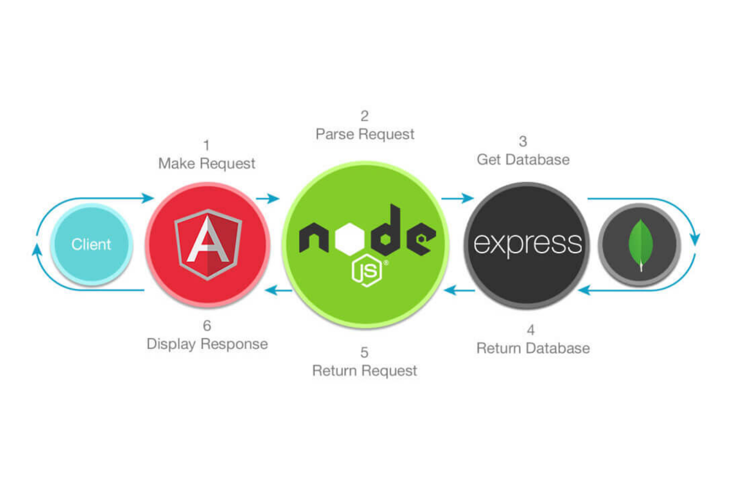
Introduction to mean stack
How Does the MEAN Stack Work?
Angular JS: Accept requests and display results to end user
NodeJS: Handle Client and Server Requests
Express JS: Make requests to Database and return a response
MongoDB: Store and retrieve data.
Image Source: https://www.thirdrocktechkno.com/blog/what-is-mean-stack-mean-stack-components-and-benefits/
Notes:
This slide talks about the case if we have to divide a subtopic further.
Left (White Color space):
Title - Parent Topic
Subtitle - Subtopic
Body Text - Description in bullets
Right (Grey Color Space):
Body Text - Relevant image (with source)/code snippet
AngularJS is a client-side language written in JavaScript. So, firstly the client request is processed by it.
After that, the request enters the server (Node.js), i.e., phase 2. Node.js is a server-side language written in JavaScript.
After that, ExpressJS makes the request to the database, and it is treated as phase 3.
After getting a request, MongoDB retrieves the data & returns the response back to the ExpressJS.
A response is sent back to the Node.js from Express.js, and then it is forwarded to the AngularJS by Node.js for displaying the result.
Reference:
https://www.thirdrocktechkno.com/blog/what-is-mean-stack-mean-stack-components-and-benefits/

Slide 5
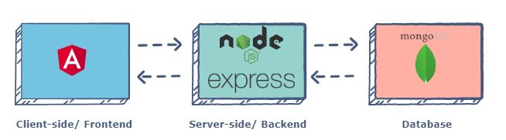
Introduction to mean stack
MEAN Stack Components
MEAN stack architecture supports the MVC.
The MEAN components are free and open-source.
It is flexible to understand and easy to use.
It helps the developers to customize as per the requirement.
Image Source: https://www.educative.io/edpresso/what-is-mean-stack
Notes:
Left (White Color space):
Title - Parent Topic
Subtitle - Subtopic 1
Body Text - Description in bullets
Right (Grey Color Space):
Body Text - Relevant image (with source)/code snippet
Angular.js Front End
At the very top of the MEAN stack is Angular.js, the self-styled “A JavaScript MVW Framework” (MVW stands for “Model View and Whatever”).
Angular.js allows you to extend your HTML tags with metadata in order to create dynamic, interactive web experiences much more powerfully than, say, building them yourself with static HTML and JavaScript (or jQuery).
Angular has all of the bells and whistles you’d expect from a front-end JavaScript framework, including form validation, localization, and communication with your back-end service.
Express.js and Node.js Server Tier
The next level down is Express.js, running on a Node.js server. Express.js calls itself a “fast, unopinionated, minimalist web framework for Node.js,” and that is indeed exactly what it is.
Express.js has powerful models for URL routing (matching an incoming URL with a server function), and handling HTTP requests and responses. By making XML HTTP requests (XHRs),r GETs, or POSTs from your Angular.js front end, you can connect to Express.js functions that power your application.
Those functions in turn use MongoDB’s Node.js drivers, either via callbacks or using Promises, to access and update data in your MongoDB database.
MongoDB Database Tier
MongoDB is a NoSQL database system. It is a cross-platform, documented oriented database which works on the concepts and the documents. It saves data in a binary format generally using JSON format which makes it easier to pass data between the client and the server.
If your application stores any data (user profiles, content, comments, uploads, events, etc.), then you’re going to want a database that’s just as easy to work with as Angular, Express, and Node.
That’s where MongoDB comes in: JSON documents created in your Angular.js front end can be sent to the Express.js server, where they can be processed and (assuming they’re valid) stored directly in MongoDB for later retrieval.
Again, if you want to easily get the best of MongoDB, you’ll want to look at MongoDB Atlas.
Reference:
https://www.educative.io/edpresso/what-is-mean-stack

Slide 6
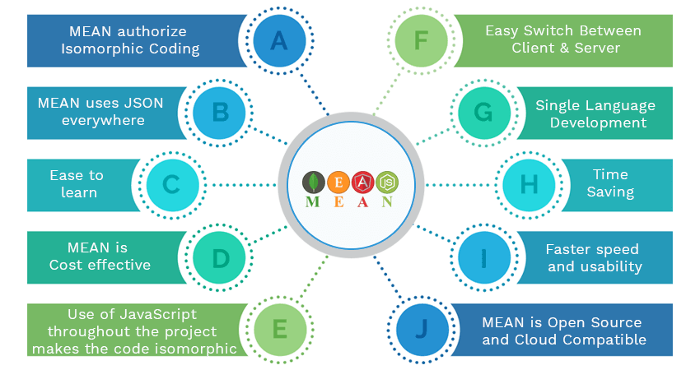
Introduction to mean stack
Benefits of using Mean Stack
MEAN makes the switching between client and server easier
Isomorphic Coding is possible with MEAN
Highly Flexible
MEAN uses JSON
Cost effective
High Speed and Reusability
Open Source and Cloud Compatible
Image Source : https://www.amarinfotech.com/wp-content/uploads/2018/05/Mean-Stack-App-Development-Advantages.png
Notes:
Left (White Color space):
Title - Parent Topic
Subtitle - Subtopic
Body Text - Description in bullets
Right (Grey Color Space):
Body Text - Relevant image (with source)/code snippet
Benefits
Allows creating a simple open source solution and build robust and maintainable solutions..
Helps in development of applications on rapid base.
MEAN is full stack JavaScript which is 100% free.
Only single uniform language throughout your stack development.
Uses very low memory footprint/overhead.
Helps you to avoid unnecessary groundwork.
Application is kept organized.
MongoDB is built for the cloud.
js simplifies the server layer.
MEAN makes code isomorphic.
Reference:
https://www.amarinfotech.com/wp-content/uploads/2018/05/Mean-Stack-App-Development-Advantages.png

Slide 7
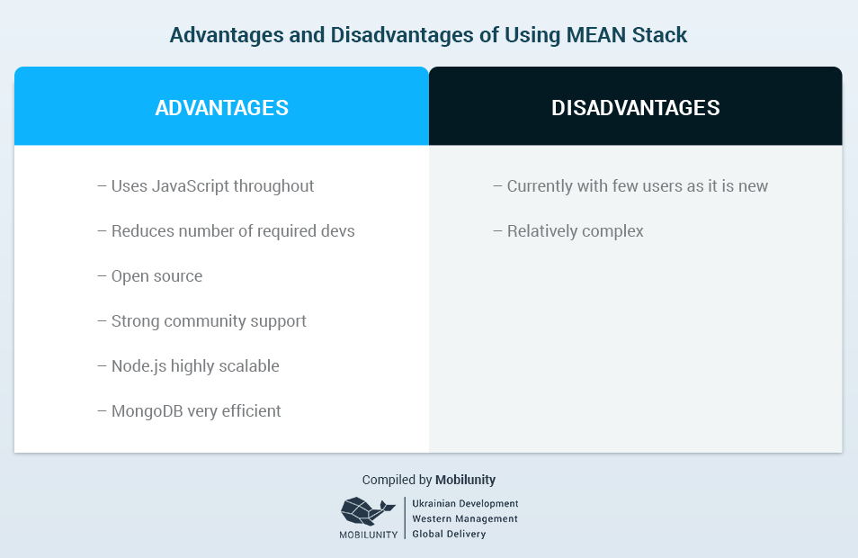
Introduction to mean stack
Disadvantages of Mean Stack
Not recommended for large-scale applications.
No specific general JS coding guidelines.
It offers poor isolation of server from business logic.
You could lose records gradually.
Image Source:https://brainleaf.com/blog/development/javascript-mean-stack-development/
Notes:
Left (White Color space):
Title - Parent Topic
Subtitle - Subtopic
Body Text - Description in bullets
Right (Grey Color Space):
Body Text - Relevant image (with source)/code snippet
Disadvantages
You could potentially lose records
The claim is that MongoDB is strongly consistent, but sometimes, this could change. When network partitioning occurs, especially in heavy load scenarios, there is a chance that you could lose records that has been successfully written by MongoDB.
This doesn’t have to happen all the time, but chances are present.
Poor isolation of server from business logic
Express.js has poor isolation of server from business logic and this prevents the reuse of certain services like batching operations. You have to go through the Express middle chain for internal jobs, and this could be bothersome.
Can’t beat the power of relational databases yet
MEAN stack, when compared to relational databases doesn’t provide the same level of functionality. Relational databases is till the first choice for many big names like Google and Facebook, as it is more reliable and stable.
Reference:
https://brainleaf.com/blog/development/javascript-mean-stack-development/

Slide 8
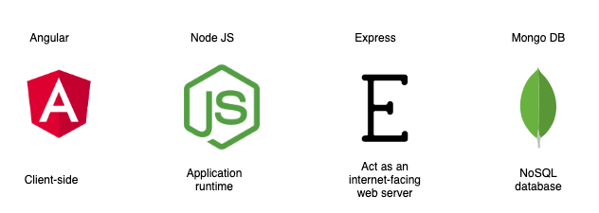
Introduction to mean stack
How secure is the MEAN stack?
Always use HTTPS
Preventing XSS & Request Forgery
Preventing SQL Injections
Security in Web API authentication
Image Source: https://miro.medium.com/max/1264/1*XywIcbNgkWiedwsXBKsDQA.pn
g
Notes:
Left (White Color space):
Title - Parent Topic
Subtitle - Subtopic
Body Text - Description in bullets
Right (Grey Color Space):
Body Text - Relevant image (with source)/code snippet
We have a team of developers who highly recommend using Mean Stack with MongoDB Atlas. As Atlas comes with built-in credentials and end-to-end encryptions, it's the best foundation for securing MongoDB. Additionally, Mean Stack comes with concrete three-tier separation using best practices and correct network isolation. There are times when it prevents end-users from accessing the business logic and database layer. The application designed using this tool is the default to avoid malicious user interaction from putting your application at risk.
Reference:
https://miro.medium.com/max/1264/1*XywIcbNgkWiedwsXBKsDQA.pn

Slide 9
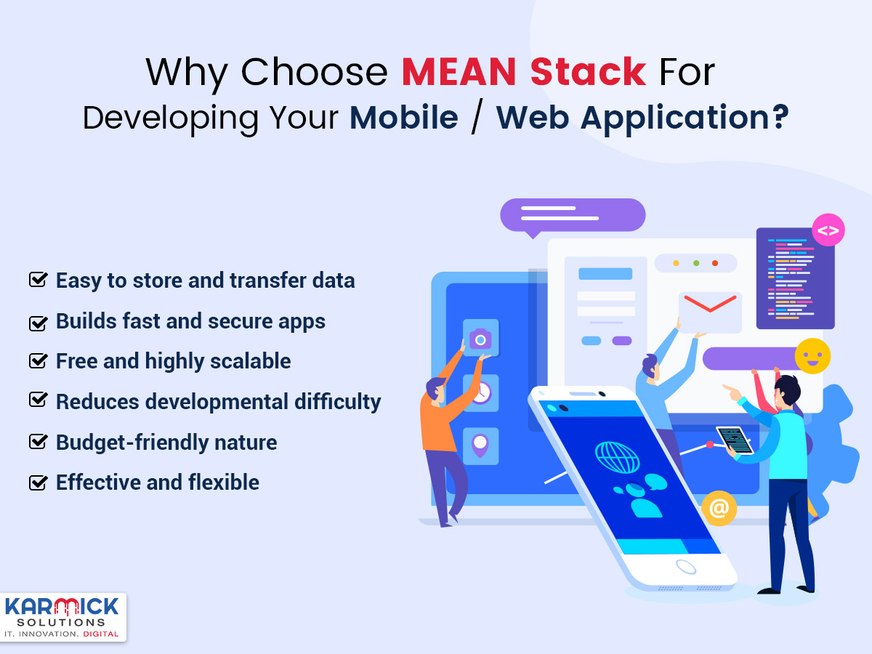
Introduction to mean stack
Why choose Mean Stack?
Scalable and Flexible
Excellent Speed
One Stack, one language
Free of Cost
User-Friendly
Avoids Rewriting
Image Source: https://karmicksolutions.com/blog/why-choose-mean-stack-for-developing-your-mobile-web-application/
Notes:
Left (White Color space):
Title - Parent Topic
Subtitle - Subtopic
Body Text - Description in bullets
Right (Grey Color Space):
Body Text - Relevant image (with source)/code snippet
Reference:
https://karmicksolutions.com/blog/why-choose-mean-stack-for-developing-your-mobile-web-application/

Slide 10
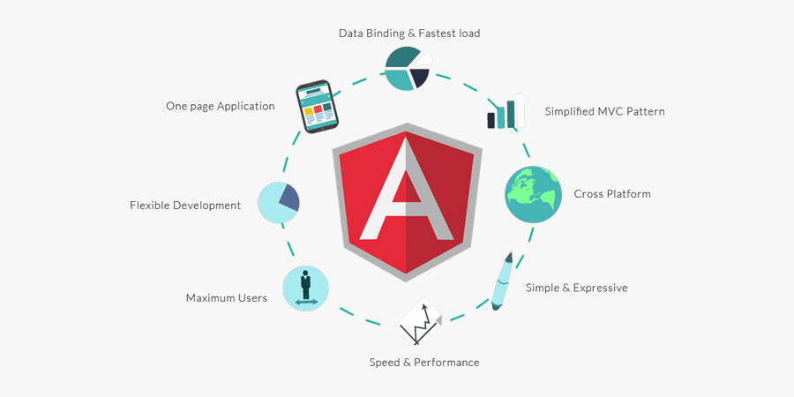
Introduction to AngularJS and UI benefits in Angular JS
Introduction to Angular JS
AngularJS is an open-source web application framework.
It was originally developed in 2009 by Misko Hevery and Adam Abrons. It is now maintained by Google.
Image Source: https://www.etatvasoft.com/blog/angular-js-the-superheroic-javascript-framework/
Notes:
This slide talks about the case if we have to divide a subtopic further.
Left (White Color space):
Title - Parent Topic
Subtitle - Subtopic 2
Body Text - Description in bullets
Right (Grey Color Space):
Body Text - Relevant image (with source)/code snippet
AngularJS is an open-source Model-View-Controller framework (MVC) that is similar to the JavaScript framework. AngularJS is probably one of the most popular modern-day web frameworks available today. This framework is used for developing mostly Single Page applications. This framework has been developed by a group of developers from Google itself.
It can be added to an HTML page with a <script> tag. It enables us to create single-page applications that only require HTML, CSS, and JavaScript on the client side.
AngularJS extends HTML attributes with Directives and Data binding to HTML with Expressions.
Reference:
https://www.etatvasoft.com/blog/angular-js-the-superheroic-javascript-framework/

Slide 11
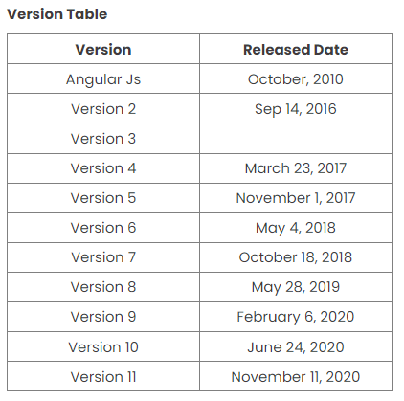
Introduction to AngularJS and UI benefits in Angular JS
Angular Version History
Angular is a well known powerful web application framework in use today.
To provide better stability and highly optimized web application, Angular has released multiple versions from time to time.
Image Source: https://www.c-sharpcorner.com/article/angular-version-change-frequency/
Notes:
Left (White Color space):
Title - Parent Topic
Subtitle - Subtopic
Body Text - Description in bullets
Right (Grey Color Space):
Body Text - Relevant image (with source)/code snippet
Angular JS 1.x - The first release was in October 2010.
Features
It is JavaScript dependent open-source front-end web application.
It is written in JavaScript.
Angular 2 - Released in September 2016.
Features
It was completely different from Angular JS. It was written in TypeScript.
It is mobile-oriented.
Angular 3 - This version was not released due to mismatched libraries.
Angular 4 - It was released in March 2014.
Features
Fast Compilation
Better Bug fixes Alert
Code size was decreased to a large extent.
Angular 5 - It was released in November 2017.
Features
It improves compiler working
Angular forms
Internationalized
Angular 6 - It was released in May 2018.
Features
Angular Elements
CLI workspace
Library Support
Tree Shakable Providers
New angular CLI commands added
Schematics
Angular 7 - It was released in Oct 2018.
Features
CLI Prompts
Bundle budgets
Angular Material and CDK
Angular 8 - It was released in May 2019.
Features
Web worker support
Builders APIs in CLI
Workspace APIs
Dynamic Imports for Route configuration
Angular 9 - It was released in Feb 2020.
Features
Ivy Compiler
Component Harnesses
TypeScript 3.7 Support
Angular 10 - It was released in June 2020.
Features
TypeScript 3.9
Optional Stricter Settings
Date Range Component
New Default Browser
Angular 11
It was released in November 2020.
Reference:
https://www.c-sharpcorner.com/article/angular-version-change-frequency/

Slide 12
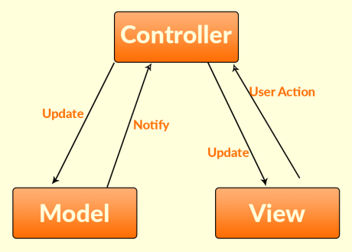
Introduction to AngularJS and UI benefits in Angular JS
AngularJS Architecture
MVC stands for Model View Controller.
It is a software design pattern for developing web applications.
Image Source: https://intellipaat.com/blog/tutorial/angularjs-tutorial/mvc-angularjs/
Notes:
Left (White Color space):
Title - Parent Topic
Subtitle - Subtopic
Body Text - Description in bullets
Right (Grey Color Space):
Body Text - Relevant image (with source)/code snippet
Model – A model in AngularJS is a primitive data type such as number, string, boolean, object, etc. It is a simple JavaScript object without any getter and setter methods.
View – In AngularJS Document Object Model (DOM) is the what users see. In order to display the data from controller, Angular expressions can be added to the view which will coordinate model and view about any modification.
Controller – Controller is a collection of JavaScript classes where application logic is defined. Model resides inside this controller.
Reference:
https://intellipaat.com/blog/tutorial/angularjs-tutorial/mvc-angularjs/

Slide 13
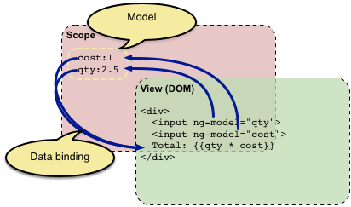
Introduction to AngularJS and UI benefits in Angular JS
Concepts of AngularJS
Modules
Directives
Expressions
Controller
Scope
Data Binding
Image Source: https://docs.angularjs.org/guide/concepts
Notes:
Left (White Color space):
Title - Parent Topic
Subtitle - Subtopic
Body Text - Description in bullets
Right (Grey Color Space):
Body Text - Relevant image (with source)/code snippet
Concept of AngularJS
Modules - A module can be defined as a container that consists of various application parts. The module is a set of functions defined in a JavaScript file. Module divides an application into small and reusable components.
Directives -Directives indicate the compiler to associate a behavior to the DOM element or modify it. Angular JS contains several directives such as ng-app, ng-controller, ng-view, ng-if, etc.
Expressions -Angular JS expressions are expressed with {{ }} which indicate a data binding in HTML. These expressions can be added into the HTML templates. Expressions do not support control flow statements while support the filters.
Controller- It is a JavaScript object constructor function that controls the AngularJS applications.
Scope- It is a JavaScript object that acts as a bridge between the Controller and the View. It is the source of data in AngularJS. Each data manipulation and assignment takes place with the help of the Scope object.
Data Binding- It coordinates the model and views any changes in either of these two.
Reference:
https://docs.angularjs.org/guide/concepts

Slide 14
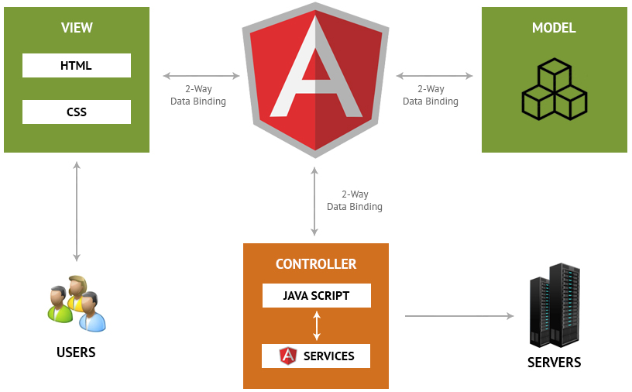
Introduction to AngularJS and UI benefits in Angular JS
Concepts of AngularJS
Validations
Filters
Services
Routing
Dependency Injection
Testing
Image Source: https://www.matridtech.net/5-key-features-of-angularjs-that-make-it-the-best-for-web-development
Notes:
Continuing from the last slide:
Left (White Color space):
Title - Parent Topic
Subtitle - Subtopic
Body Text - Description in bullets
Right (Grey Color Space):
Body Text - Relevant image (with source)/code snippet
Validations- Validations take place with the help of AngularJS forms and controls.
Filters -These let you display the formatting of data on DOM in Angular and extend the behavior of directives and binding expressions. Filters format the values or apply specific.
Services -These are singletons that are used by directives, controllers, or other services.
Routing -The service $routeProvider handles the operations of Routing. It divides the map into various views . It helps split the Single Page Applications into different views.
Dependency Injection-It is a design pattern used to handle the dependencies of various components of a software. It lets you develop loosely-structured architectures.
Testing -The codes developed by Dependency Injections are tested. Some of the popular testing frameworks like Jasmine and Karma are two widely-used technologies.
Reference:
https://www.matridtech.net/5-key-features-of-angularjs-that-make-it-the-best-for-web-development

Slide 15
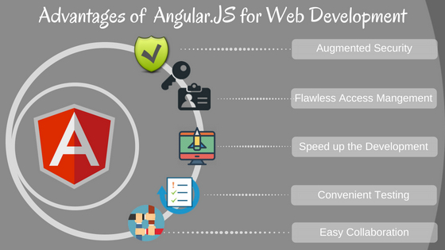
Introduction to AngularJS and UI benefits in Angular JS
Advantages of AngularJS
Easy to Learn
It has a Two-Way Binding Feature
Supports SPA features
Has a Declarative UI
Supported by Google
Allows for Optimal Web Application Management
It is a Powerful Framework
Real-Time Testing
Image Source: https://www.v2web.in/blog/5-advantages-of-angular-js-for-web-development/
Notes:
Left (White Color space):
Title - Parent Topic
Subtitle - Subtopic
Body Text - Description in bullets
Right (Grey Color Space):
Body Text - Relevant image (with source)/code snippet
Advantages
It provides the capability to create Single Page Application in a very clean and maintainable way.
It provides data binding capability to HTML. Thus, it gives user a rich and responsive experience.
AngularJS code is unit testable.
AngularJS uses dependency injection and make use of separation of concerns.
AngularJS provides reusable components.
With AngularJS, the developers can achieve more functionality with short code.
In AngularJS, views are pure html pages, and controllers written in JavaScript do the business processing.
Reference:
https://www.v2web.in/blog/5-advantages-of-angular-js-for-web-development/

Slide 16
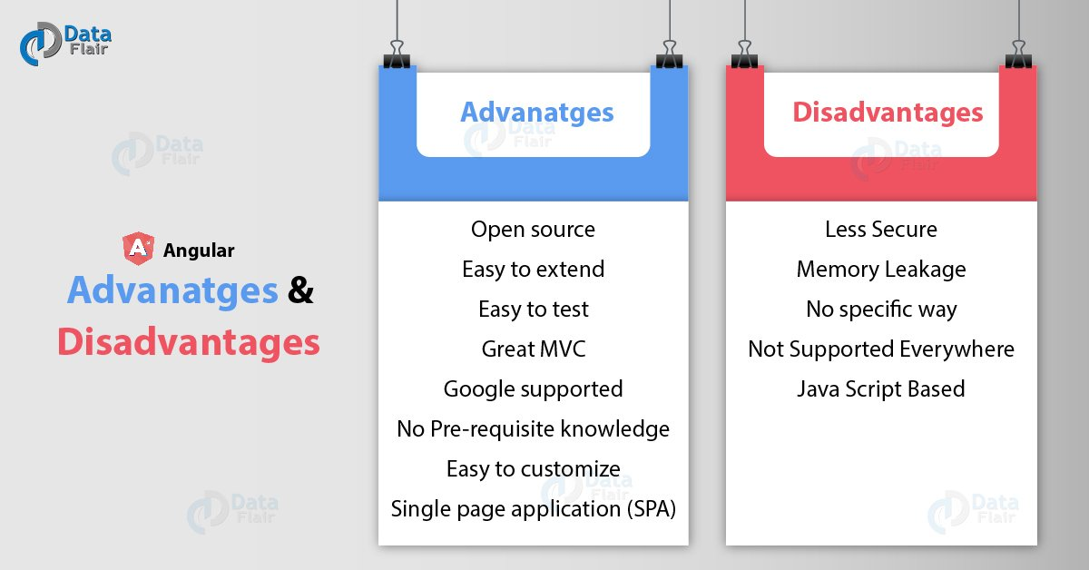
Introduction to AngularJS and UI benefits in Angular JS
Disadvantages of AngularJS
Not Secure
Not degradable
Complex at times
Image Source: https://data-flair.training/blogs/wp-content/uploads/sites/2/2019/01/Angular-Advanatges-Disadvanatges-01.jpg
Notes:
Left (White Color space):
Title - Parent Topic
Subtitle - Subtopic
Body Text - Description in bullets
Right (Grey Color Space):
Body Text - Relevant image (with source)/code snippet
Diadvantages
Not Secure − Being JavaScript only framework, application written in AngularJS are not safe. Server side authentication and authorization is must to keep an application secure.
Not degradable − If the user of your application disables JavaScript, then nothing would be visible, except the basic page.
Complex at times – At times AngularJS becomes complex to handles as there are multiple ways to do the same thing. This creates confusion and requires considerable efforts.
Reference:
https://data-flair.training/blogs/wp-content/uploads/sites/2/2019/01/Angular-Advanatges-Disadvanatges-01.jpg

Slide 17
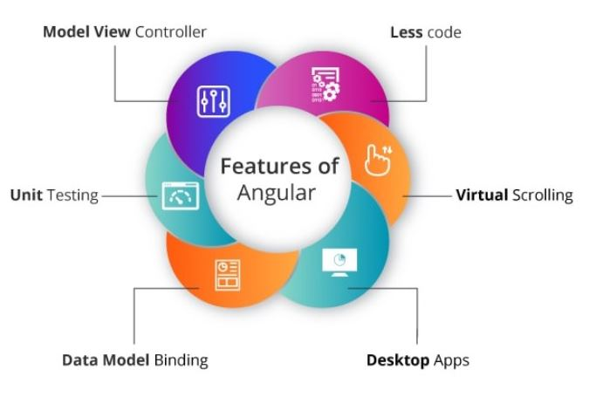
Introduction to AngularJS and UI benefits in Angular JS
General features
Data Binding.
Architecture.
Directives.
Not Browser Specific.
Codeless.
Speed and Performance.
Dependency Injection.
Deep Linking.
Image Source: https://www.educative.io/edpresso/what-is-mean-stack
Notes:
Left (White Color space):
Title - Parent Topic
Subtitle - Subtopic
Body Text - Description in bullets
Right (Grey Color Space):
Body Text - Relevant image (with source)/code snippet
Features
We can create rich internet application by using Angular JS.
Angular js Allow us to write the client-side code using javascript in an MVC way.
AngularJs provides cross-browser compliant and it automatically handles JavaScript code suitable for each browser.
The AngularJs is Completely free and opensource it is used by thousands of developers all around the world.
Angularjs is used to build high-performance, large scale, and easy-to-maintain web applications.
Reference:
https://www.educative.io/edpresso/what-is-mean-stack

Slide 18
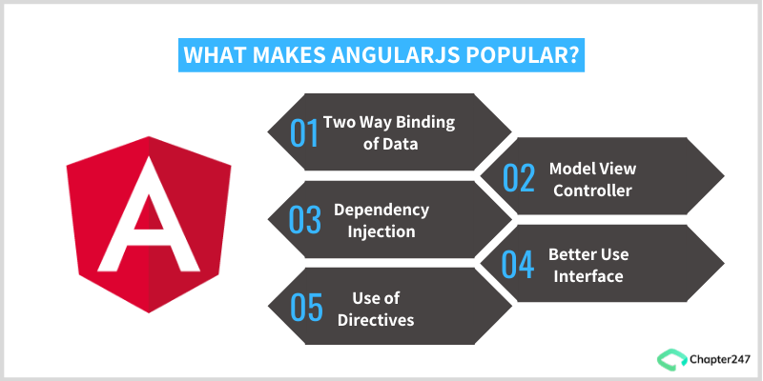
Introduction to AngularJS and UI benefits in Angular JS
UI benefits in Angular JS
Provides immense support to XAML
Provides a simplistic approach to data binding
Reduces application side-effects by allowing developers to express Declarative UI
Simplifies testing
Gives Design development workflow a
Makes Single Page Applications easy
Image Source: https://www.chapter247.com/blog/top-features-and-benefits-of-angularjs/
Notes:
This slide talks about the case if we have to divide a subtopic further.
Left (White Color space):
Title - Parent Topic
Subtitle - Subtopic
Body Text - Description in bullets
Right (Grey Color Space):
Body Text - Relevant image (with source)/code snippet
Provides immense support to XAML Development
XAML is an XML based markup language which is used to instantiate object graphs and set values. It allows you to define various types of objects with properties. It makes it easy to layout complex, ever changing UIs. It also supports for data-binding which allows a symbiosis between the presentation layer and your data without creating hard dependencies between its components. It also enables a developer to conduct any number of testing scenarios. AngularJS translates very well with XAML principles. It also allows a parallel workflow between different aspects that include the markup for the UI itself as well as the underlying logic that fetches and processes data.
Provides a simplistic approach to data binding
Data binding is very easy in the Angular world. The framework eliminates the need to derive from an existing object or place all your properties and dependencies cards on the table. AngularJS uses dirty tracking to enable this. Though several existing frameworks have evolved, the process of mapping everything explicitly to an interim object to data-bind to Angular is significantly easier and faster.
Reduces application side-effects by allowing developers to express declarative UI
Declarative UI has several advantages. A structured UI enables easy understanding and manipulation of the application. Using jQuery forces the developer to know a lot about the document structure which often creates two issues: first, a fairly unstable code working as “glue” that tightly grips the changes in the UI, and second, there is an uncertainty because it is hard to judge by studying the markup just how the UI would function. Placing markup directly in HTML, one can separate the presentation logic from imperative logic and keep it in one place. Understanding of the extended markup provided by Angular i.e. code snippets makes the whereabouts of the data amply clear. The addition, tools like directives and filters not only make the UI intent even more clear but also give clarity on how the information is being shaped.
Simplifies testing
AngularJS product engineering adeptly embraces Test-Driven Development, Behavior-Driven Development, or any of the driven-development methodologies of building an application. It helps in saving time and change the way an application is structured. Angular can help to test everything UI behavior to business logic with its ability to mock dependencies.
Gives Design development workflow a new meaning
Even though HTML and CSS support design, but AngularJS allows a developer to add a markup without completely breaking an application. It often depends on a certain id or structure to locate an element and perform tasks. Developers can rearrange portions of code by moving the elements around and the corresponding code that does the binding and filtering job moves with it.
Makes Single Page Applications easy
The growing popularity of Single Page Applications among AngularJS development companies is not unfounded as they cater to a very specific need. With more and more functionality finding its way to the web, developers are progressively realizing the potential of the browser as a distributed computing node. SPA boasts of more responsive design and can provide an experience of a native app on the web. AngularJS is an apt infrastructure that supports routing, templates, and even journaling making it viable accomplice of SPA.
Here are some additional advantages to leverage for awesome front-end product engineering:
Improved Plug & Play Features – AngularJS makes it easy to add components from an existing application to a new application. It only needs a copy-paste command to make your existing assets available in a new environment.
Quicker Development Turnaround Time – AngularJS supported by the MVC architecture ensures faster development, testing, and maintenance. The quicker turnaround time allows developers to enhance their productivity.
Superior Dependency Handling – One of the biggest USPs of AngularJS is its “dependency injection”. Testing and Single Page Application have been enormously simplified because of the dependency injection feature.
Makes Parallel Development Possible – Apart from faster development, AngularJS in collaboration with MVC architecture allows the developer to perform parallel application development which makes it stand-out amongst the competition.
Gives More Control to the Developers – AngularJS directives give superior control to developers, who get a free hand to experiment with HTML and attributes. The directives allow them more independence to help them create more responsive platforms.
State Management Made Easy – AngularJS helps you manage any application state easily whether it is illusioned or disillusioned. It is highly conducive when it comes to managing properties, permissions, and other major concerns across the application.
Reference:
https://www.chapter247.com/blog/top-features-and-benefits-of-angularjs/

Slide 19
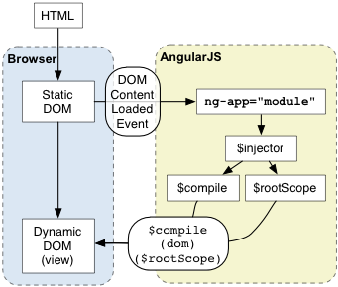
Usage of Angular JS with HTML
AngularJS with HTML
AngularJS is a JavaScript framework. It can be added to an HTML page with a <script> tag. AngularJS extends HTML attributes with Directives, and binds data to HTML with Expressions.
Image Source: https://docs.angularjs.org/guide/bootstrap
Notes:
This slide talks about the case if we have to divide a subtopic further.
Title Box - Parent Topic
Subtitle box - Sub Topic 3
Body Text - Subtopic divisions (Subtopics of subtopics)
Reference:
https://www.thirdrocktechkno.com/blog/what-is-mean-stack-mean-stack-components-and-benefits/

Slide 20
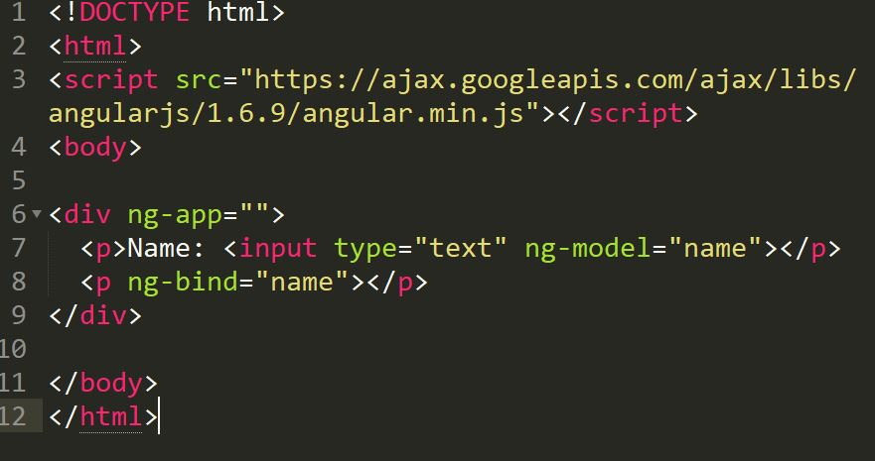
Usage of Angular JS with HTML
AngularJS with HTML
AngularJS is a JavaScript framework. It can be added to an HTML page with a <script> tag. AngularJS extends HTML attributes with Directives, and binds data to HTML with Expressions.
Notes:
Continuing from the last slide:
Title Box - Parent Topic
Subtitle box - Sub Topic
Body Text - Subtopic divisions (Subtopics of subtopics)
AngularJS extends HTML with ng-directives.
The ng-app directive defines an AngularJS application.
The ng-model directive binds the value of HTML controls (input, select, textarea) to application data.
The ng-bind directive binds application data to the HTML view.
Reference:

Slide 21
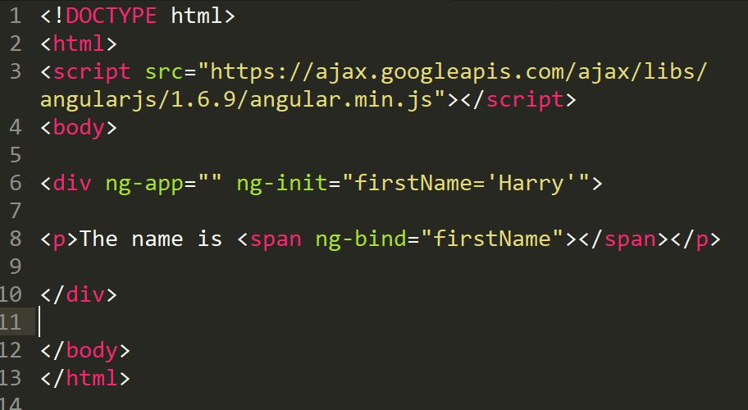
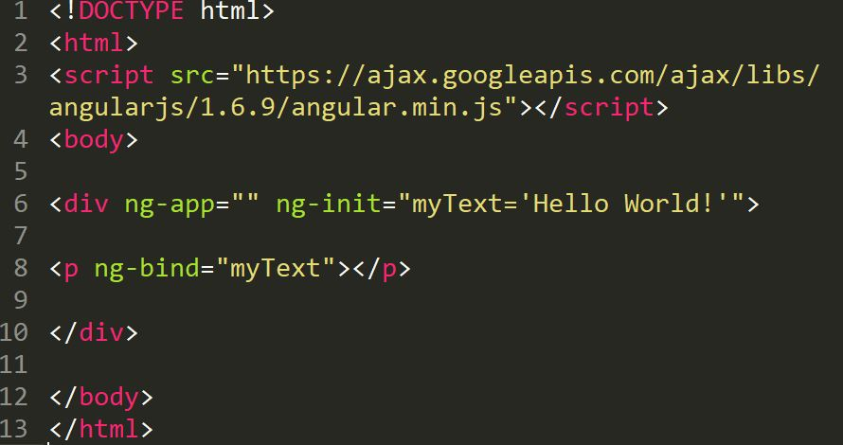
Usage of Angular JS with HTML
AngularJS Directives & Expressions
The ng-init directive initializes AngularJS application variables.
AngularJS expressions are written inside double braces: {{ expression }}.
Notes:
Title Box - Parent Topic
Subtitle box - Sub Topic
Body Text - Subtopic divisions (Subtopics of subtopics)
As you have already seen, AngularJS directives are HTML attributes with an ng prefix.
The ng-init directive initializes AngularJS application variables
AngularJS expressions bind AngularJS data to HTML the same way as the ng-bind directive.
The ng-bind directive tells AngularJS to replace the content of an HTML element with the value of a given variable, or expression.
If the value of the given variable, or expression, changes, the content of the specified HTML element will be changed as well.
Reference:

Slide 22
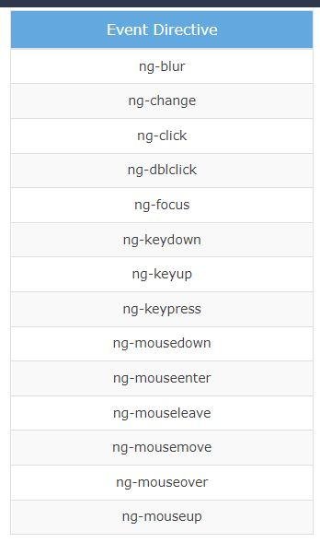
Event Handling in Angular JS
Event Handling
AngularJS includes certain directives which can be used to provide custom behavior on various DOM events, such as click, dblclick, mouseenter etc.
Image Source: https://www.guru99.com/images/AngularJS/010416_0549_AngularJSIn1.png
Notes:
This slide talks about the case if we have to divide a subtopic further.
Title Box - Parent Topic
Subtitle box - Sub Topic 4
Body Text - Subtopic divisions (Subtopics of subtopics)
ng-mousemove: Movement of mouse leads to the execution of event.
ng-mouseup: Movement of mouse upwards leads to the execution of event.
ng-mousedown: Movement of mouse downwards leads to the execution of event.
ng-mouseenter: Click of the mouse button leads to the execution of event.
ng-mouseover: Hovering of the mouse leads to the execution of event.
ng-cut: Cut operation leads to the execution of the event.
ng-copy: Copy operation leads to the execution of the event.
ng-keypress: Press of key leads to the execution of the event.
ng-keyup: Press of upward arrow key leads to the execution of the event.
ng-keydown: Press of downward arrow key leads to the execution of the event.
ng-click: Single click leads to the execution of the event.
ng-dblclick: Double click leads to the execution of the event.
Reference:
https://www.guru99.com/images/AngularJS/010416_0549_AngularJSIn1.png

Slide 23
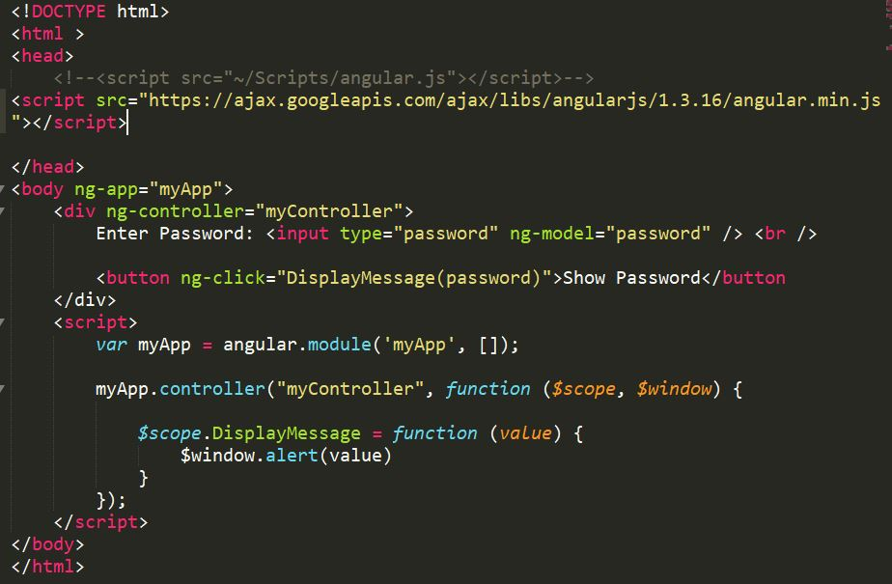
Event Handling in Angular JS
AngularJS Events
Mouse Events
Click Events
Keyboard Events
Notes:
Title Box - Parent Topic
Subtitle box - Sub Topic
Body Text - Subtopic divisions (Subtopics of subtopics)
The ng-click directive is used to provide event handler for click event.
Reference:

Slide 24
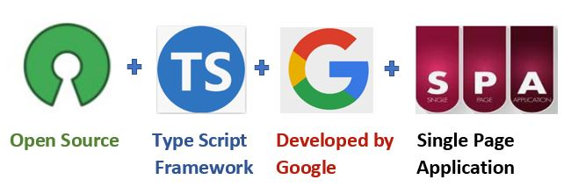
Introduction Angular & difference b/w angular-1 and angular-5
Introduction Angular
Angular is a platform and framework for building single-page client applications using HTML and TypeScript
Image Source: https://www.c-sharpcorner.com/article/what-is-angular-and-features-release-in-angular-13/
Notes:
This slide talks about the case if we have to divide a subtopic further.
Title Box - Parent Topic
Subtitle box - Sub Topic 5
Body Text - Subtopic divisions (Subtopics of subtopics)
Angular is written in TypeScript. It implements core and optional functionality as a set of TypeScript libraries that you import into your applications.
Reference:
https://www.c-sharpcorner.com/article/what-is-angular-and-features-release-in-angular-13/

Slide 25
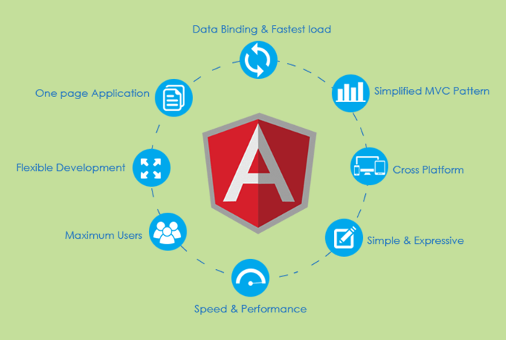
Introduction Angular & difference b/w angular-1 and angular-5
Top 12 Angular Features
Cross-platform
Efficient MVC architecture
Sectional structure
The eminence of Angular CLI
Data binding
Set of Directives
Image Source: https://www.mobileappdaily.com/angular-framework-best-use-casess
Notes:
.
Title Box - Parent Topic
Subtitle box - Sub Topic
Body Text - Subtopic divisions (Subtopics of subtopics)
Cross-platform
It is imperative to have this factor first on the Angular features list because Angular plays a prominent role in developing Progressive Web Applications (PWA). With PWA by your side, audiences can enjoy an app-like experience using contemporary web capabilities. Most importantly, with this feature, you can deploy a local or a progressive app.
Efficient MVC architecture
The Model-View-Controller (MVC) architecture is among the leading Angular 8 features. MVC enhances the worth of the framework for client-side application development and takes care of other features like data binding and scopes. As compared to other frameworks, MVC blends in all the necessary elements of the application to waive off extra coding.
Sectional structure
The best part about the Angular framework is it helps in organizing code into different modules as and when you build them. Due to this feature, there is a division of overall functionality into reusable code. Furthermore, this helps in the division of tasks among the Angular developers and permits web applications to accomplish lazy loading.
The eminence of Angular CLI
Angular’s Command Line Interface (CLI) is a boon for web development. CLI helps in automating certain processes with simple commands. You may add or remove defined functionalities with a combination of these simple commands. In addition, it enables running units’ tests and end-to-end tests swiftly. All these AngularJS features enhance the code quality considerably.
Data binding
With data binding by your side, a user can easily manipulate web page elements through a web browser. It utilizes dynamic HTML and waives off intricate scripting or programming. Data binding plays a vital role when coming up with web pages equipped with interactive components, like games, tutorials, etc. Also, when a web page has way too much data, it enables a better display.
Besides, a model is a place where you make edits in the application. Those changes are reflected in UI elements. When the model changes, the developer supposedly has to make manual edits in the DOM elements, and then the attributes start reflecting. It is a cumbersome task, but Angular eliminates it with two-way data-binding. This process helps in synchronizing the DOM and the model, and vice versa.
Set of Directives
AngularJS expands the functionality of HTML with a set of inbuilt attributes, also known as directives. The imperative functionality of these directives is to boost the competence of HTML. With this, it becomes immensely appropriate for dynamic client-side applications. The best part is these directives can be self-initiated using AngularJS.
Reference:
https://www.mobileappdaily.com/angular-framework-best-use-casess

Slide 26
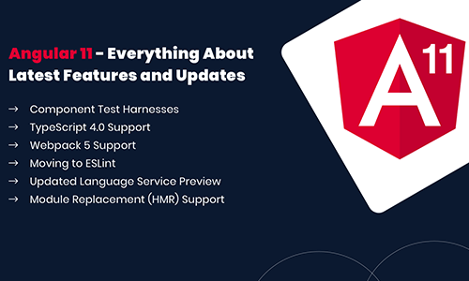
Introduction Angular & difference b/w angular-1 and angular-5
Top 12 Angular Features
Prominence of TypeScript
Declarative UI
Extensive documentation and support
The prowess of Ivy Renderer
Test-friendliness
Timely upgradations
Image Source: https://www.angularminds.com/blog/article/top-features-of-angular-11.html
Notes:
Continuing from the last slide:
Title Box - Parent Topic
Subtitle box - Sub Topic
Body Text - Subtopic divisions (Subtopics of subtopics)
Prominence of TypeScript
TypeScript is the superscript of JavaScript. The main advantage of using TypeScript is you can detect and correct errors in the code while writing. It also supports AngularJS security features like primitive and interface. Interestingly, Angular is written using TypeScript and boasts all these features.
Declarative UI
One of the AngularJS key features is declarative UI. In Angular, you can skip using JavaScript to outline the UI of your web application and instead use HTML as it is less complicated than JavaScript. HTML is a blessing for Angular applications as it imports declarative and intuitive properties of the UI components. With properties like these, you don’t have to initiate manual program flows. Instead, you can simply describe the page layout and the path of the data. Further, Angular declarative UI takes care of the components as per the layout. With this, ample time and effort are saved in front-end development.
Extensive documentation and support
Google supports Angular because of the stability of the framework. Most importantly, Google has enriched the Angular community with documentation and tools to build functionalities and resolve issues. Due to these reasons, a developer is never helpless in the Angular community. The answers are readily available either in the documents or in the online forums.
The prowess of Ivy Renderer
A renderer helps in translating a code written in TypeScript and HTML into standard JavaScript instructions. With this, it helps the browser to interpret. Renderer makes your components and templates understandable for the browser to display them aptly. Furthermore, with its tree shaking technique, Ivy Renderer removes unused code, making the web application smaller and boosting its loading speed. All in all, this feature reduces the size of the Angular framework and makes the bundle a bit smaller.
Test-friendliness
JavaScript is an interpreted language, which makes it imperative for developers to test the code capability. But while using AngularJS, developers are unhindered by this requirement. The framework has features like Dependency Injection (DI) that supports testing. DI simplifies the entire process where the testers must insert the test data in the controller and parallelly check the output. It’s that simple!
Timely upgradations
If you don’t upgrade your framework from time to time, you may lag in this race of the digital world. New settings pour in, and if they are absent, your application will be tagged as outdated. To eliminate this problem, Angular improves its Component Development Kit (CDK) on a timely basis. It not only enhances but also takes care of the angular version upgrades.
Reference:
https://www.angularminds.com/blog/article/top-features-of-angular-11.html

Slide 27
Introduction Angular & difference b/w angular-1 to angular-5
Angular 1 | Angular 5
Released by Google in the year 2010. | Released by Google in the year 2017.
JavaScript-based framework for creating SPA. | Angular 5 comes with build optimizer which is a part of the platform’s command like a tool.
Still supported but no longer will be developed.
The architecture of AngularJS is based on MVC.
AngularJS was not developed with a mobile base in mind.
AngularJS code can write by using only ES5, ES6, and Dart. | Compiler Improvements
Based on controllers whose scope is now over. | New Router Lifecycle Event
Factory, service, provider, value and constant are used for services | Optimization with HTTP Client Feature Internationalized Date & Currency
Run on only client-side
ng-app and angular bootstrap function are used to initialize
Difference b/wAngular-1 to Angular-5
Prominence of TypeScript
Declarative UI
Extensive documentation and support
The prowess of Ivy Renderer
Test-friendliness
Timely upgradations
Notes:
Title Box - Parent Topic
Subtitle box - Sub Topic
Body Text - Subtopic divisions (Subtopics of subtopics)
Angular JS
AngularJS is the official name, but some developers also refer to this as Angular 1. It is a front-end and open-source web application framework based on JavaScript. It uses HTML as a template in this framework. In AngularJS, the data and expressions are merged to create an expressive environment for developing web applications quickly. It simplifies both the testing and development of applications by providing a framework for client-side model–view–controller (MVC) and Model–View–ViewModel (MVVM) architectures, along with components commonly used in rich Internet applications.
It uses the controller approach where the view communicates using a $scope.
Angular 5
Angular 5 is more advanced and has more enhanced features than Angular 4. The best feature of Angular 5 is that it aids developers in removing unnecessary codes from their applications.
Other improved features are a code-sharing feature, less time for assembling dynamic web applications, and so on. Moreover, it has DOM support, and its compiler helps with incremental compilation.
Reference:

Slide 28
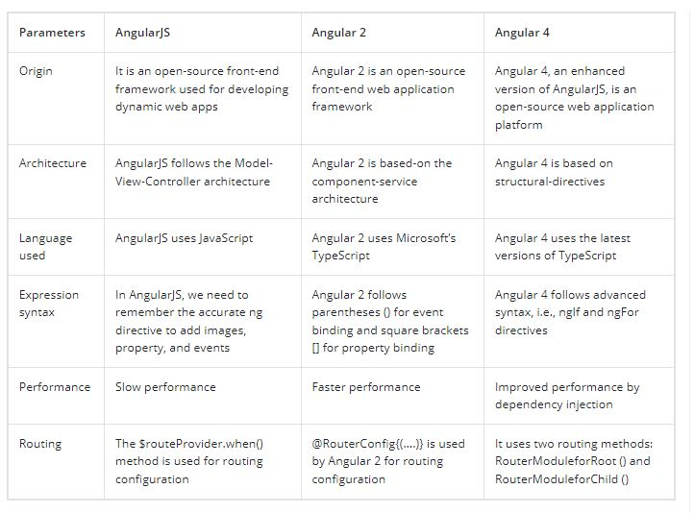
Introduction Angular & difference b/w angular-1 to angular-5
It is a JavaScript Framework
It provides HTML support.
Allows event handling and data binding
Animation and form package
Image Source: https://www.angularminds.com/blog/article/top-features-of-angular-11.html​
Notes:
Title Box - Parent Topic
Subtitle box - Sub Topic
Body Text - Subtopic divisions (Subtopics of subtopics)
Angular JS
AngularJS is the official name, but some developers also refer to this as Angular 1. It is a front-end and open-source web application framework based on JavaScript. It uses HTML as a template in this framework. In AngularJS, the data and expressions are merged to create an expressive environment for developing web applications quickly. It simplifies both the testing and development of applications by providing a framework for client-side model–view–controller (MVC) and Model–View–ViewModel (MVVM) architectures, along with components commonly used in rich Internet applications.
It uses the controller approach where the view communicates using a $scope.
Angular 5
Angular 5 is more advanced and has more enhanced features than Angular 4. The best feature of Angular 5 is that it aids developers in removing unnecessary codes from their applications.
Other improved features are a code-sharing feature, less time for assembling dynamic web applications, and so on. Moreover, it has DOM support, and its compiler helps with incremental compilation.
Reference:
https://www.angularminds.com/blog/article/top-features-of-angular-11.html

Slide 29
In this section, we will discuss:
Type Script Datatype & Operator
Type Script String & Tuple, Oops
Object & Class
Inheritance & Interface
Angular js Child Component
Angular js Data Binding, Event Binding,2 Way Binding
Notes:
Mention the parent topics one by one. This particular learning outcome has 4 parent topics.

Slide 30
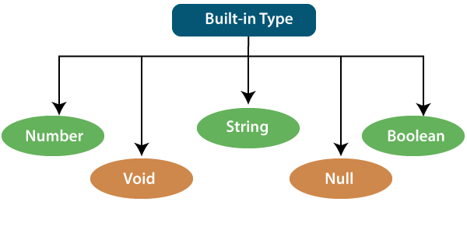
Type Script Datatype & Operator
Type Script Datatype
Whenever a variable is created, the intention is to assign some value to that variable but what type of value can be assigned to that variable is dependent upon the datatype of that Variable.
In typeScript, type System represents different types of datatypes which are supported by TypeScript.
Image Source:https://static.javatpoint.com/tutorial/typescript/images/typescript-types2.png
Notes:
Left (White Color space):
Title - Parent Topic
Subtitle - Subtopic 1
Body Text - Description in bullets
Right (Grey Color Space):
Body Text - Relevant image (with source)/code snippet
Put reference links in Speaker Notes
Reference:
https://www.tutorialspoint.com/internet_technologies/internet_overview.htm/

Slide 31
Type Script Datatype & Operator
Type Script Datatype
TypeScript has some pre-defined data-types
Number
Boolean
String
Void
Null
Image Source:https://static.javatpoint.com/tutorial/typescript/images/typescript-types2.png
Notes:
Left (White Color space):
Title - Parent Topic
Subtitle - Subtopic 1
Body Text - Description in bullets
Right (Grey Color Space):
Body Text - Relevant image (with source)/code snippet
Put reference links in Speaker Notes
Reference:
https://www.tutorialspoint.com/internet_technologies/internet_overview.htm/

Slide 32
Type Script Datatype & Operator
Number Datatype
Just like JavaScript, TypeScript supports number data type.
All numbers are stored as floating-point numbers.
These numbers can be Decimal (base 10), Hexadecimal (base 16) or Octal (base 8).
Image Source:https://static.javatpoint.com/tutorial/typescript/images/typescript-types2.png
Notes:
Left (White Color space):
Title - Parent Topic
Subtitle - Subtopic 1
Body Text - Description in bullets
Right (Grey Color Space):
Body Text - Relevant image (with source)/code snippet
Put reference links in Speaker Notes
Reference:
https://www.tutorialspoint.com/internet_technologies/internet_overview.htm/

Slide 33
Type Script Datatype & Operator
Boolean Datatype
Boolean values are supported by both JavaScript and TypeScript and stored as true/false values.
The upper-case Boolean is an object type whereas lower case boolean is a primitive type.
Image Source:https://static.javatpoint.com/tutorial/typescript/images/typescript-types2.png
Notes:
Left (White Color space):
Title - Parent Topic
Subtitle - Subtopic 1
Body Text - Description in bullets
Right (Grey Color Space):
Body Text - Relevant image (with source)/code snippet
Put reference links in Speaker Notes
Reference:
https://www.tutorialspoint.com/internet_technologies/internet_overview.htm/

Slide 34
Type Script Datatype & Operator
String Datatype
String is another primitive data type that is used to store text data.
String values are surrounded by single quotation marks or double quotation marks.
Image Source:https://static.javatpoint.com/tutorial/typescript/images/typescript-types2.png
Notes:
Left (White Color space):
Title - Parent Topic
Subtitle - Subtopic 1
Body Text - Description in bullets
Right (Grey Color Space):
Body Text - Relevant image (with source)/code snippet
Put reference links in Speaker Notes
Reference:
https://www.tutorialspoint.com/internet_technologies/internet_overview.htm/

Slide 35
Type Script Datatype & Operator
Void Datatype
Similar to languages like Java, void is used where there is no data.
For example, if a function does not return any value then you can specify void as return type.
There is no meaning to assign void to a variable, as only null or undefined is assignable to void.
Image Source:https://static.javatpoint.com/tutorial/typescript/images/typescript-types2.png
Notes:
Left (White Color space):
Title - Parent Topic
Subtitle - Subtopic 1
Body Text - Description in bullets
Right (Grey Color Space):
Body Text - Relevant image (with source)/code snippet
Put reference links in Speaker Notes
Reference:
https://www.tutorialspoint.com/internet_technologies/internet_overview.htm/

Slide 36
Type Script Datatype & Operator
Null Datatype
TypeScript has a powerful system to deal with null or undefined values.
Null and undefined are primitive types and can be used like other types, such as string.
Image Source:https://static.javatpoint.com/tutorial/typescript/images/typescript-types2.png
Notes:
Left (White Color space):
Title - Parent Topic
Subtitle - Subtopic 1
Body Text - Description in bullets
Right (Grey Color Space):
Body Text - Relevant image (with source)/code snippet
Put reference links in Speaker Notes
Reference:
https://www.tutorialspoint.com/internet_technologies/internet_overview.htm/

Slide 37

Typescript Operator
What is Typescript Operator
In TypeScript, an operator can be classified into the following ways:
Arithmetic Operators
Comparison (Relational) Operators
Logical Operators
Bitwise Operators
Assignment Operators
Ternary/Conditional Operator
Concatenation Operator
Type Operators
Image Source: https://discoversdkcdn.azureedge.net/postscontent/typeScript/operators in typescript.png
Notes:
This slide talks about the case if we have to divide a subtopic further.
Title Box - Parent Topic
Subtitle box - Sub Topic
Body Text - Subtopic divisions (Subtopics of subtopics)

Slide 38

What is Typescript Operator
Arithmetic Operators
Arithmetic operators take numeric values as their operands, performs an action, and then returns a single numeric value.
The most common arithmetic operators are addition (+), subtraction (-), multiplication (*), and division (/).
Image Source:https://www.tektutorialshub.com/wp-content/uploads/2020/09/Arithmetic-Operators-in-Typescript.jpg
Notes:
This slide talks about the case if we have to divide a subtopic further.
Title Box - Parent Topic
Subtitle box - Sub Topic
Body Text - Subtopic divisions (Subtopics of subtopics)

Slide 39

What is Typescript Operator
Comparison Operators
The comparison operators are used to compares the two operands.
These operators return a Boolean value true or false.
Image Source: https://www.tektutorialshub.com/wp-content/uploads/2020/09/Comparison-or-relational-operators-in-Typescript.jpg
Notes:
This slide talks about the case if we have to divide a subtopic further.
Title Box - Parent Topic
Subtitle box - Sub Topic
Body Text - Subtopic divisions (Subtopics of subtopics)

Slide 40
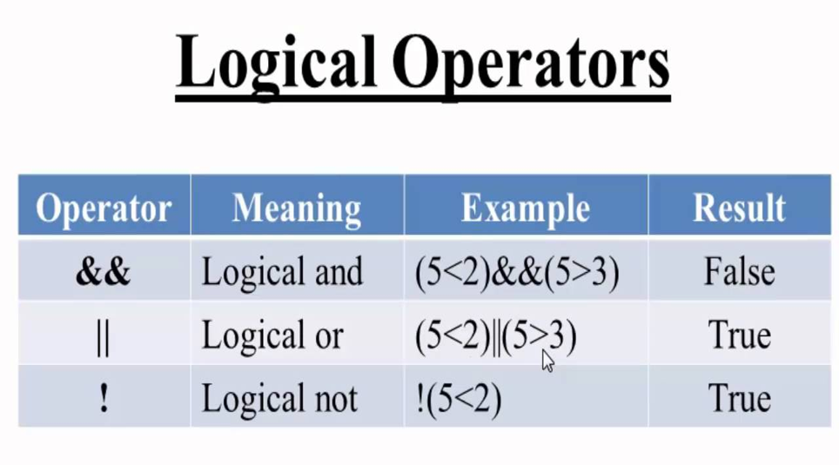
What is Typescript Operator
Logical Operators
Logical operators are used for combining two or more condition into a single expression and return the Boolean result true or false.
Image Source: http://enlightsolution.com/wp-content/uploads/2019/07/logical-operator.png
Notes:
This slide talks about the case if we have to divide a subtopic further.
Title Box - Parent Topic
Subtitle box - Sub Topic
Body Text - Subtopic divisions (Subtopics of subtopics)

Slide 41
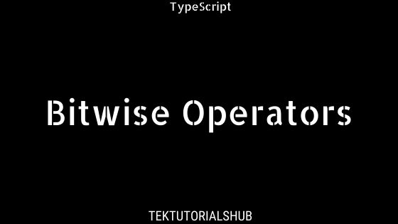
What is Typescript Operator
Bitwise Operators
The bitwise operators perform the bitwise operations on operands.
Image Source:https://www.tektutorialshub.com/wp-content/uploads/2020/09/Bitwise-Operators-in-Typescript.jpg
Notes:
This slide talks about the case if we have to divide a subtopic further.
Title Box - Parent Topic
Subtitle box - Sub Topic
Body Text - Subtopic divisions (Subtopics of subtopics)

Slide 42
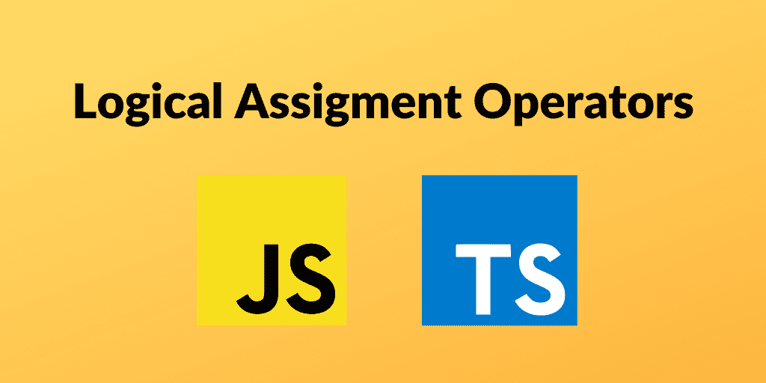
What is Typescript Operator
Assignment Operators
Assignment operators are used to assign a value to the variable.
The left side of the assignment operator is called a variable, and the right side of the assignment operator is called a value.
The data-type of the variable and value must be the same otherwise the compiler will throw an error.
Image Source: https://www.carlrippon.com/static/94667e436c1a793603017f278ad70724/26df7/banner.png
Notes:
This slide talks about the case if we have to divide a subtopic further.
Title Box - Parent Topic
Subtitle box - Sub Topic
Body Text - Subtopic divisions (Subtopics of subtopics)

Slide 43
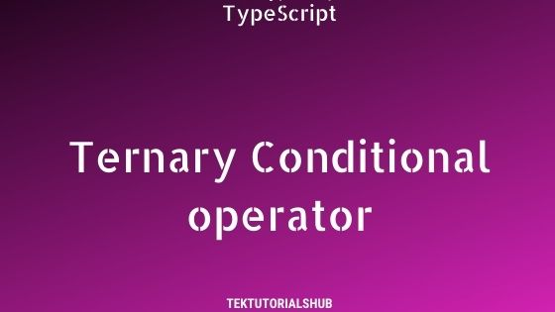
What is Typescript Operator
Ternary/Conditional Operators
The conditional operator takes three operands and returns a Boolean value based on the condition, whether it is true or false.
Its working is similar to an if-else statement.
The conditional operator has right-to-left associativity.
Image Source:https://www.tektutorialshub.com/wp-content/uploads/2020/09/Ternary-Conditional-operator-in-Typescript.jpg
Notes:
This slide talks about the case if we have to divide a subtopic further.
Title Box - Parent Topic
Subtitle box - Sub Topic
Body Text - Subtopic divisions (Subtopics of subtopics)

Slide 44
What is Typescript Operator
Concatenation Operators
The concatenation (+) operator is an operator which is used to append the two string.
In concatenation operation, we cannot add a space between the strings.
We can concatenate multiple strings in a single statement.
Image Source: https://discoversdkcdn.azureedge.net/postscontent/typeScript/operators in typescript.png
Notes:
This slide talks about the case if we have to divide a subtopic further.
Title Box - Parent Topic
Subtitle box - Sub Topic
Body Text - Subtopic divisions (Subtopics of subtopics)

Slide 45
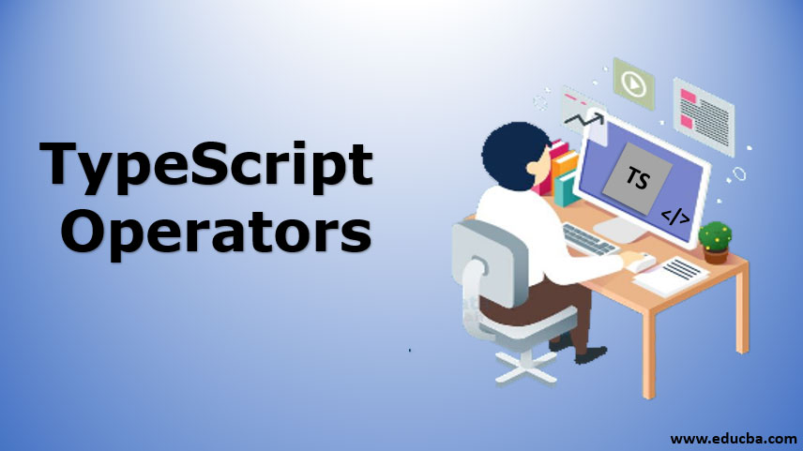
What is Typescript Operator
Type Operators
There are a collection of operators available which can assist you when working with objects in TypeScript.
Operators such as typeof, instanceof, in, and delete are the examples of Type operator.
Image Source:https://cdn.educba.com/academy/wp-content/uploads/2019/12/typescript-operators1.jpg
Notes:
This slide talks about the case if we have to divide a subtopic further.
Title Box - Parent Topic
Subtitle box - Sub Topic
Body Text - Subtopic divisions (Subtopics of subtopics)

Slide 46
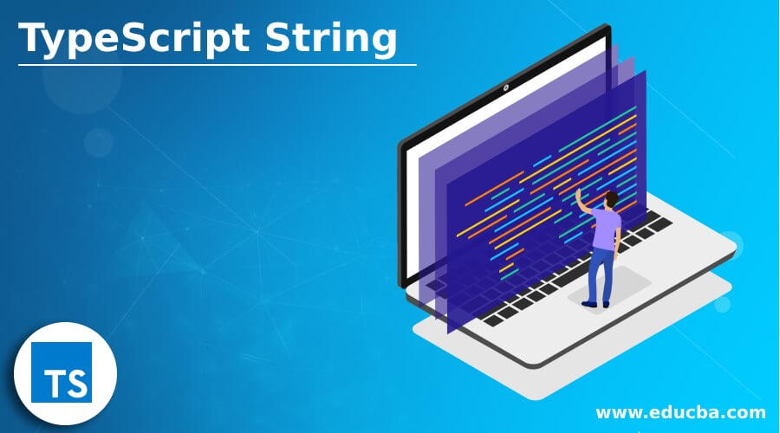
Type Script String & Tuple, Oops
TypeScript String
In TypeScript, the string is an object which represents the sequence of character values.
It is a primitive data type which is used to store text data.
The string values are surrounded by single quotation mark or double quotation mark.
An array of characters works the same as a string.
Image Source:https://cdn.educba.com/academy/wp-content/uploads/2021/01/TypeScript-String.jpg
Notes:
This slide talks about the case if we have to divide a subtopic further.
Title Box - Parent Topic
Subtitle box - Sub Topic
Body Text - Subtopic divisions (Subtopics of subtopics)

Slide 47
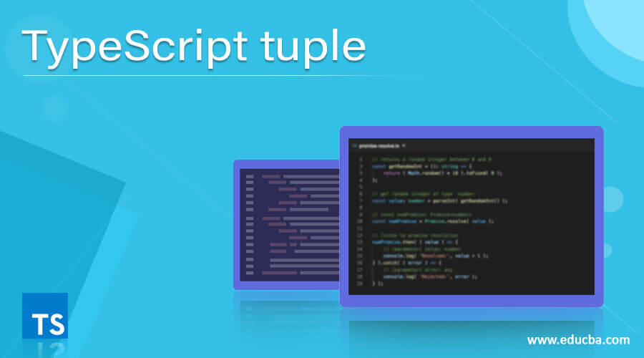
Type Script String & Tuple, Oops
TypeScript Tuple
A tuple is a data type which can be used like any other variables.
It represents the heterogeneous collection of values and can also be passed as parameters in a function call.
Image Source:https://cdn.educba.com/academy/wp-content/uploads/2020/12/TypeScript-tuple.jpg
Notes:
This slide talks about the case if we have to divide a subtopic further.
Title Box - Parent Topic
Subtitle box - Sub Topic
Body Text - Subtopic divisions (Subtopics of subtopics)

Slide 48
TypeScript Tuple
Accessing tuple Elements
We can read or access the fields of a tuple by using the index, which is the same as an array.
In Tuple, the index starts from zero.
Image Source: HTTPs://cdn.educba.com/academy/wp-content/uploads/2020/12/TypeScript-tuple.jpg
Notes:
This slide talks about the case if we have to divide a subtopic further.
Title Box - Parent Topic
Subtitle box - Sub Topic
Body Text - Subtopic divisions (Subtopics of subtopics)

Slide 49
Type Script String & Tuple, Oops
Operations on Tuple
A tuple has two operations:
Push()
Pop()
Image Source:https://cdn.educba.com/academy/wp-content/uploads/2020/12/TypeScript-tuple.jpg
Notes:
This slide talks about the case if we have to divide a subtopic further.
Title Box - Parent Topic
Subtitle box - Sub Topic
Body Text - Subtopic divisions (Subtopics of subtopics)

Slide 50
Type Script String & Tuple, Oops
Operations on Tuple
A tuple has two operations:
Push(): The push operation is used to add an element to the tuple.
Pop(): The pop operation is used to remove an element from the tuple.
Image Source:https://cdn.educba.com/academy/wp-content/uploads/2020/12/TypeScript-tuple.jpg
Notes:
This slide talks about the case if we have to divide a subtopic further.
Title Box - Parent Topic
Subtitle box - Sub Topic
Body Text - Subtopic divisions (Subtopics of subtopics)

Slide 51
TypeScript Tuple
Update or Modify the Tuple Elements
Tuples are mutable, which means we can update or change the values of tuple elements. To modify the fields of a Tuple, we need to use the index of the fields and assignment operator.
Image Source:https://cdn.educba.com/academy/wp-content/uploads/2020/12/TypeScript-tuple.jpg
Notes:
This slide talks about the case if we have to divide a subtopic further.
Title Box - Parent Topic
Subtitle box - Sub Topic
Body Text - Subtopic divisions (Subtopics of subtopics)

Slide 52
TypeScript Tuple
Clear the fields of a Tuple
We cannot delete the tuple variable, but its fields could be cleared.
To clear the fields of a tuple, assign it with an empty set of tuple field
Image Source:https://cdn.educba.com/academy/wp-content/uploads/2020/12/TypeScript-tuple.jpg
Notes:
This slide talks about the case if we have to divide a subtopic further.
Title Box - Parent Topic
Subtitle box - Sub Topic
Body Text - Subtopic divisions (Subtopics of subtopics)

Slide 53
Type Script String & Tuple, Oops
Typescript OOPS
Object Oriented Programming or OOP is a programming paradigm that has four principles which are:
Inheritance,
Abstraction,
Polymorphism,
And Encapsulation.
Image Source:https://cdn.educba.com/academy/wp-content/uploads/2021/01/TypeScript-String.jpg
Notes:
This slide talks about the case if we have to divide a subtopic further.
Title Box - Parent Topic
Subtitle box - Sub Topic
Body Text - Subtopic divisions (Subtopics of subtopics)

Slide 54
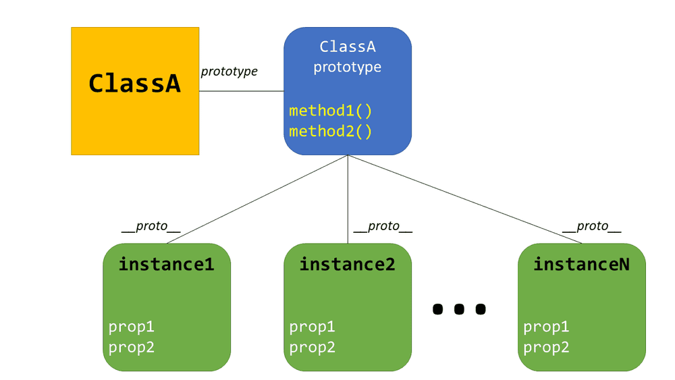
Object and Classes
Creating classes
Use the class keyword to declare a class in TypeScript. The syntax for the same is given below −
Syntax
class class_name {
//class scope
}
Image Source: https://instil.co/static/bbc9de35a7b1d565aaec5974bd860ed5/00d43/Prototype.png
Notes:
This slide talks about the case if we have to divide a subtopic further.
Title Box - Parent Topic
Subtitle box - Sub Topic
Body Text - Subtopic divisions (Subtopics of subtopics)

Slide 55
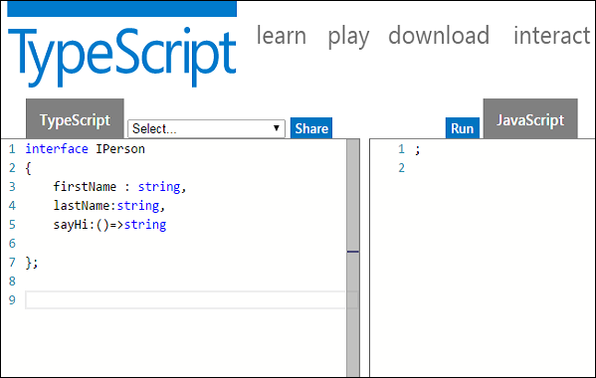
Inheritance & Interface
What is Interfaces & Inheritance
An interface can be extended by other interfaces.
In other words, an interface can inherit from other interface.
Typescript allows an interface to inherit from multiple interfaces.
Image Source:https://www.tutorialspoint.com/typescript/images/interface_and_objects.jpg
Notes:
This slide talks about the case if we have to divide a subtopic further.
Title Box - Parent Topic
Subtitle box - Sub Topic
Body Text - Subtopic divisions (Subtopics of subtopics)

Slide 56
Inheritance & Interface
What is Interfaces & Inheritance
Single Interface Inheritance
Multiple Interface Inheritance
Image Source: https://www.tutorialspoint.com/typescript/images/interface_and_objects.jpg
Notes:
This slide talks about the case if we have to divide a subtopic further.
Title Box - Parent Topic
Subtitle box - Sub Topic
Body Text - Subtopic divisions (Subtopics of subtopics)

Slide 57
Inheritance & Interface
Single Interface Inheritance
Syntax:
Child_interface_name extends super_interface_name
Image Source: https://www.tutorialspoint.com/typescript/images/interface_and_objects.jpg
Notes:
This slide talks about the case if we have to divide a subtopic further.
Title Box - Parent Topic
Subtitle box - Sub Topic
Body Text - Subtopic divisions (Subtopics of subtopics)

Slide 58
Inheritance & Interface
Single Interface Inheritance
Syntax:
Child_interface_name extends super_interface1_name,
super_interface2_name,…,super_interfaceN_name
Image Source:https://www.tutorialspoint.com/typescript/images/interface_and_objects.jpg
Notes:
This slide talks about the case if we have to divide a subtopic further.
Title Box - Parent Topic
Subtitle box - Sub Topic
Body Text - Subtopic divisions (Subtopics of subtopics)

Slide 59
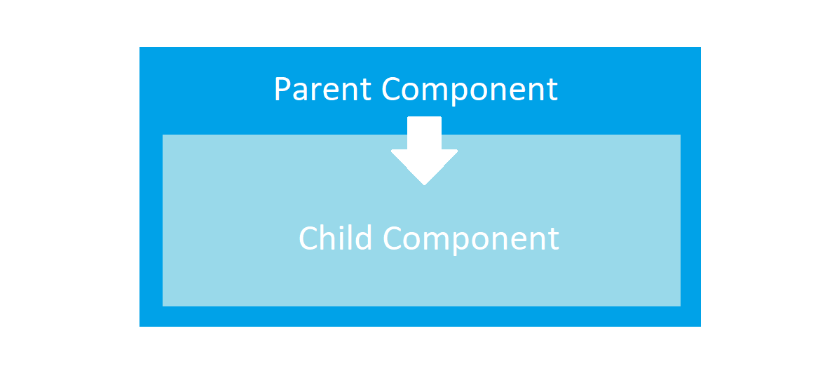
Angular js Child Component
Advantages of Components:
simpler configuration than plain directives
promote sane defaults and best practices
optimized for component-based architecture
writing component directives will make it easier to upgrade to Angular
Image Source: https://miro.medium.com/max/1400/1*_GApyQ-Q3A45KWl8ImbLbw.png
Notes:
Continuing from the last slide:
Title - Subtopic
Subtitle - Subtopic of Subtopic
Body - Description

Slide 60
Angular js Child Component
When not to use Components:
For directives that need to perform actions in compile and pre-link functions, because they aren't available
when you need advanced directive definition options like priority, terminal, multi-element
when you want a directive that is triggered by an attribute or CSS class, rather than an element
Image Source: https://miro.medium.com/max/1400/1*_GApyQ-Q3A45KWl8ImbLbw.png
Notes:
Continuing from the last slide:
Title - Subtopic
Subtitle - Subtopic of Subtopic
Body - Description

Slide 61
Angular js Child Component
Creating and configuring a Component
Components can be registered using the .component() method of an AngularJS module (returned by angular.module()).
Image Source: https://miro.medium.com/max/1400/1*_GApyQ-Q3A45KWl8ImbLbw.png
Notes:
Continuing from the last slide:
Title - Subtopic
Subtitle - Subtopic of Subtopic
Body - Description

Slide 62
Angular js Child Component
Component-based application architecture
Components have a well-defined public API - Inputs and Outputs:
However, scope isolation only goes so far, because AngularJS uses two-way binding.
So if you pass an object to a component like this - bindings: {item: '='}, and modify one of its properties, the change will be reflected in the parent component.
Image Source: https://miro.medium.com/max/1400/1*_GApyQ-Q3A45KWl8ImbLbw.png
Notes:
Continuing from the last slide:
Title - Subtopic
Subtitle - Subtopic of Subtopic
Body - Description

Slide 63
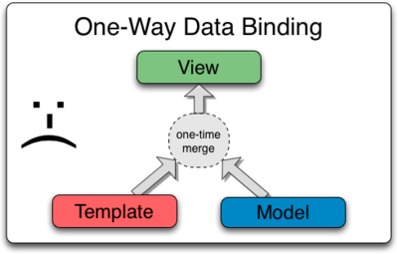
Angular js Data Binding, Event Binding,2 Way Binding
Angular js Data Binding
Components have a well-defined public API - Inputs and Outputs:
However, scope isolation only goes so far, because AngularJS uses two-way binding.
So if you pass an object to a component like this - bindings: {item: '='}, and modify one of its properties, the change will be reflected in the parent component.
Image Source:https://docs.angularjs.org/img/One_Way_Data_Binding.png
Notes:
Continuing from the last slide:
Title - Subtopic
Subtitle - Subtopic of Subtopic
Body - Description

Slide 64

Angular js Data Binding, Event Binding,2 Way Binding
How To Bind Events In AngularJS
We want the user to be able to take an action, and cause something to happen on the page.
Users will enter text into input boxes, pick items from lists and click buttons.
These types of user actions result in a flow of data from an element to a component.
Image Source:https://vegibit.com/wp-content/uploads/2018/11/How-To-Bind-Events-In-AngularJS.png
Notes:
Continuing from the last slide:
Title - Subtopic
Subtitle - Subtopic of Subtopic
Body - Description

Slide 65
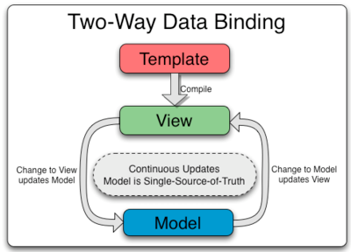
Angular js Data Binding, Event Binding,2 Way Binding
Two Way Data Binding
Two-way binding gives components in your application a way to share data.
Use two-way binding to listen for events and update values simultaneously between parent and child components.
Image Source:https://www.javatpoint.com/js/angularjs/images/two-way-data-binding.png
Notes:
Continuing from the last slide:
Title - Subtopic
Subtitle - Subtopic of Subtopic
Body - Description

Slide 66
In this section, we will discuss:
Angular JS Pipe
Angular js Routing
Angular js Services
Angular js Http Request
Node Introduction
Blocking & Nonblocking code
Notes:
Mention the parent topics one by one. This particular learning outcome has 4 parent topics.

Slide 67
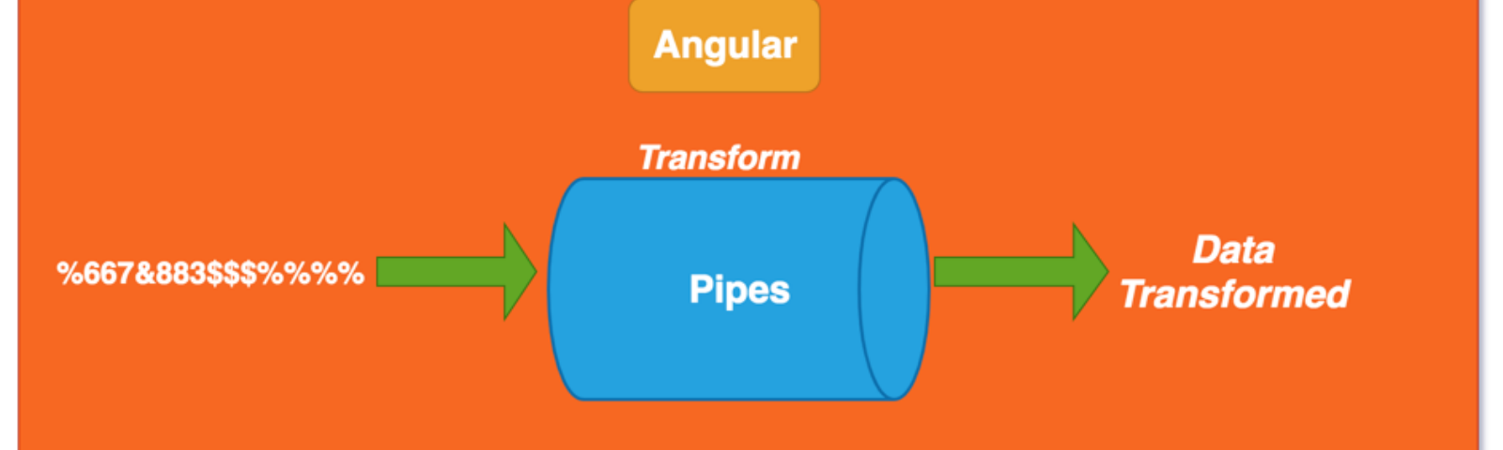
Angular JS Pipe
What is Pipe?
The pipe symbol (|) is used for applying filters in AngularJS. A filter is a function that is invoked for handling model transformations.
Its basically just a global function that doesn't require registration of functions on a scope, and offers more convenient syntax to regular function calls.
Image Source:https://cdn-images-1.medium.com/fit/t/1600/480/1*q8_BX2R8hPe8BpkvPOWgEQ.png
Notes:
Left (White Color space):
Title - Parent Topic
Subtitle - Subtopic 1
Body Text - Description in bullets
Right (Grey Color Space):
Body Text - Relevant image (with source)/code snippet
Put reference links in Speaker Notes
Reference:
https://www.tutorialspoint.com/internet_technologies/internet_overview.htm/

Slide 68
Angular JS Pipe
What is Pipe?
A pipe class must implement the PipeTransform interface.
A pipe must belong to an NgModule in order for it to be available to a template.
Angular Pipes are used to transform data on a template, without writing a boilerplate code in a component.
Image Source: https://cdn-images-1.medium.com/fit/t/1600/480/1*q8_BX2R8hPe8BpkvPOWgEQ.png
Notes:
Left (White Color space):
Title - Parent Topic
Subtitle - Subtopic 1
Body Text - Description in bullets
Right (Grey Color Space):
Body Text - Relevant image (with source)/code snippet
Put reference links in Speaker Notes
Reference:
https://www.tutorialspoint.com/internet_technologies/internet_overview.htm/

Slide 69
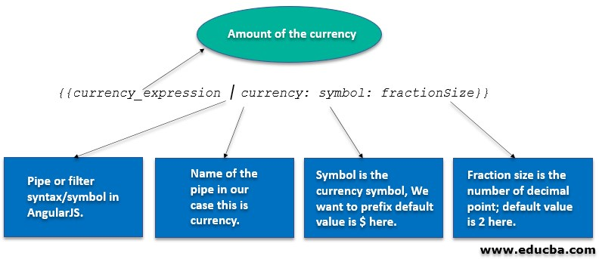
Angular JS Pipe
Why Pipe?
A pipe takes in data as input and transforms it to the desired output. It is like a filter in Angular 1 (AngularJS).
We can use the pipe on a template using Pipe Operator | .As shown below,
{{today | date : ‘fullDate’}}
Image Source: https://cdn.educba.com/academy/wp-content/uploads/2020/03/JavaScript-References-lll.jpg
Notes:
Left (White Color space):
Title - Parent Topic
Subtitle - Subtopic 1
Body Text - Description in bullets
Right (Grey Color Space):
Body Text - Relevant image (with source)/code snippet
Put reference links in Speaker Notes
Reference:
https://www.tutorialspoint.com/internet_technologies/internet_overview.htm/

Slide 70
Angular JS Pipe
Why Pipe?
here,
today is the component variable, which specifies the current date.
date represent DataPipe
fullDate is an optional parameter or argument which specifies the date format.
Image Source: https://cdn.educba.com/academy/wp-content/uploads/2020/03/JavaScript-References-lll.jpg
Notes:
Left (White Color space):
Title - Parent Topic
Subtitle - Subtopic 1
Body Text - Description in bullets
Right (Grey Color Space):
Body Text - Relevant image (with source)/code snippet
Put reference links in Speaker Notes
Reference:
https://www.tutorialspoint.com/internet_technologies/internet_overview.htm/

Slide 71
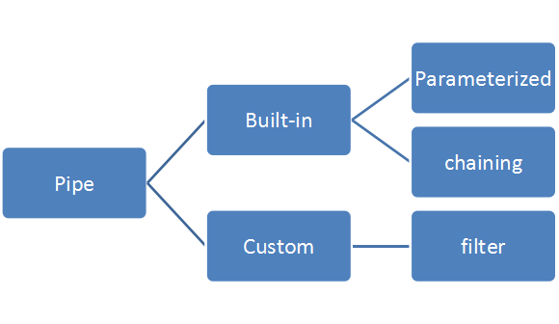
Angular JS Pipe
Types of Pipe
There are two types of Pipe:
Build-In Pipe
Custom Pipe
Image Source: https://miro.medium.com/max/580/1*znGD7VrQ6nlZkAOsuPmJDg.png
Notes:
Left (White Color space):
Title - Parent Topic
Subtitle - Subtopic 1
Body Text - Description in bullets
Right (Grey Color Space):
Body Text - Relevant image (with source)/code snippet
Put reference links in Speaker Notes
Reference:
https://www.tutorialspoint.com/internet_technologies/internet_overview.htm/

Slide 72
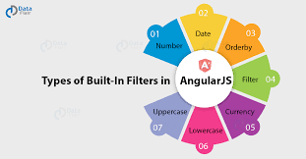
Angular JS Pipe
Built-In Pipes
Angular comes with a collection of built-in pipes such as:
DatePipe
UpperCasePipe
LowerCasePipe
CurrencyPipe
DecimalPipe
PercentPipe
Image Source: https://miro.medium.com/max/1400/1*lVD2Qe8zAD3qnXHRj-dI1w.png
Notes:
Left (White Color space):
Title - Parent Topic
Subtitle - Subtopic 1
Body Text - Description in bullets
Right (Grey Color Space):
Body Text - Relevant image (with source)/code snippet
Put reference links in Speaker Notes
Reference:
https://www.tutorialspoint.com/internet_technologies/internet_overview.htm/

Slide 73
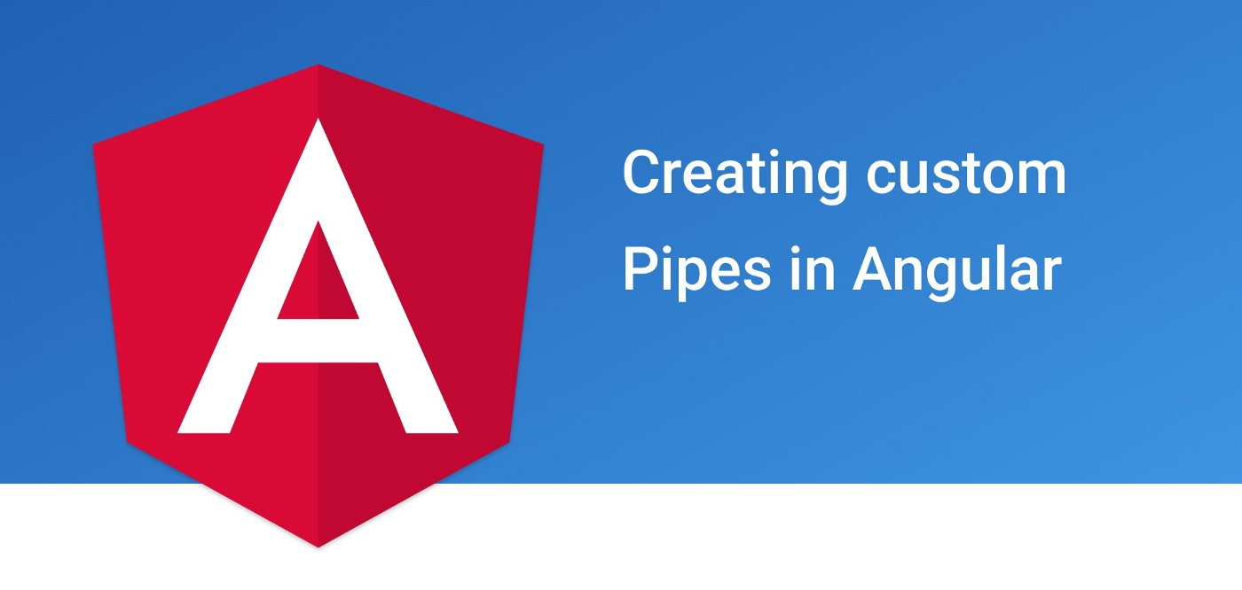
Angular JS Pipe
Custom Pipe
Custom Pipes can be of two types. Pure and impure custom pipe. Pipe takes an input and returns an output based on the output of transform function evaluation.
Image Source: https://miro.medium.com/max/1400/1*PVzEV4fnMji3JF-MpPhduA.jpeg
Notes:
Left (White Color space):
Title - Parent Topic
Subtitle - Subtopic 1
Body Text - Description in bullets
Right (Grey Color Space):
Body Text - Relevant image (with source)/code snippet
Put reference links in Speaker Notes
Reference:
https://www.tutorialspoint.com/internet_technologies/internet_overview.htm/

Slide 74
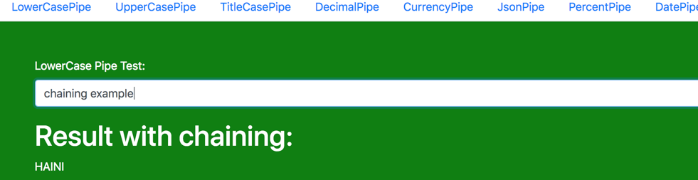
Pipe Chaining
What Is Pipe Channing?
The chaining Pipe is used to perform the multiple operations within the single expression. This chaining operation will be chained using the pipe (I).
Image Source: https://miro.medium.com/max/1400/1*JfjKPYK3qWE2bmVjQNIupg.png
Notes:
Left (White Color space):
Title - Parent Topic
Subtitle - Subtopic 1
Body Text - Description in bullets
Right (Grey Color Space):
Body Text - Relevant image (with source)/code snippet
Put reference links in Speaker Notes
Reference:
https://www.tutorialspoint.com/internet_technologies/internet_overview.htm/

Slide 75

Pipe Chaining
What Is Parameterizing Pipe?
A pipe can accept any number of optional parameters to achieve output. The parameter value can be any valid template expressions. To add optional parameters follow the pipe name with a colon (:). Its looks like- currency: 'INR'
Image Source: https://miro.medium.com/max/1400/1*JfjKPYK3qWE2bmVjQNIupg.png
Notes:
Left (White Color space):
Title - Parent Topic
Subtitle - Subtopic 1
Body Text - Description in bullets
Right (Grey Color Space):
Body Text - Relevant image (with source)/code snippet
Put reference links in Speaker Notes
Reference:
https://www.tutorialspoint.com/internet_technologies/internet_overview.htm/

Slide 76
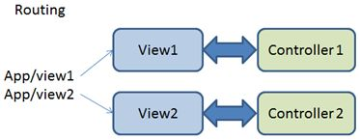
Angular js Routing
What Is Angular js Routing
Routing is a core feature in AngularJS. This feature is useful in building SPA (Single Page Application) with multiple views.
In SPA application, all views are different Html files and we use Routing to load different part of application and its help to divide application logically and make it manageable.
Image Source: https://csharpcorner-mindcrackerinc.netdna-ssl.com/UploadFile/ff2f08/routing-in-angularjs/Images/Routing.jpg
Notes:
Left (White Color space):
Title - Parent Topic
Subtitle - Subtopic 1
Body Text - Description in bullets
Right (Grey Color Space):
Body Text - Relevant image (with source)/code snippet
Put reference links in Speaker Notes
Reference:
https://www.tutorialspoint.com/internet_technologies/internet_overview.htm/

Slide 77
Angular js Routing
Introduction to ngRoute Module
This module provides routing in AngularJS application and also provides deep linking services and directives. To achieve routing in AngularJS, we need to include the library file of ngRoute.
Image Source: https://csharpcorner-mindcrackerinc.netdna-ssl.com/UploadFile/ff2f08/routing-in-angularjs/Images/Routing.jpg
Notes:
Left (White Color space):
Title - Parent Topic
Subtitle - Subtopic 1
Body Text - Description in bullets
Right (Grey Color Space):
Body Text - Relevant image (with source)/code snippet
Put reference links in Speaker Notes
Reference:
https://www.tutorialspoint.com/internet_technologies/internet_overview.htm/

Slide 78
Angular js Routing
Component of ngRoute Module
There are four main components of ngRoute module:
ngView
$routeProvider
$route
$routeParams
Image Source: https://csharpcorner-mindcrackerinc.netdna-ssl.com/UploadFile/ff2f08/routing-in-angularjs/Images/Routing.jpg
Notes:
Left (White Color space):
Title - Parent Topic
Subtitle - Subtopic 1
Body Text - Description in bullets
Right (Grey Color Space):
Body Text - Relevant image (with source)/code snippet
Put reference links in Speaker Notes
Reference:
https://www.tutorialspoint.com/internet_technologies/internet_overview.htm/

Slide 79
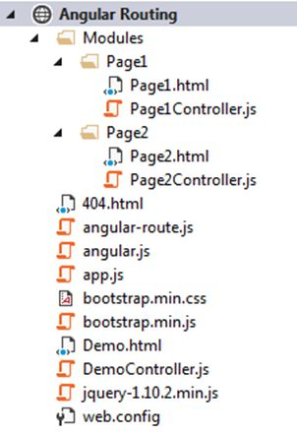
Angular js Routing
Hello World Example
Routing in AngularJS is used to load different templates at runtime. In the following example we will elaborate it more step by step.
Step 1: Create basic structure of application (SPA).
Image Source: https://csharpcorner-mindcrackerinc.netdna-ssl.com/UploadFile/ff2f08/routing-in-angularjs/Images/Project%20structure.jpg
Notes:
Left (White Color space):
Title - Parent Topic
Subtitle - Subtopic 1
Body Text - Description in bullets
Right (Grey Color Space):
Body Text - Relevant image (with source)/code snippet
Put reference links in Speaker Notes
Reference:
https://www.tutorialspoint.com/internet_technologies/internet_overview.htm/

Slide 80
Angular js Routing
Hello World Example
Step 2: Add Routing
Step 3: Define HTML Template and controller
Image Source: https://csharpcorner-mindcrackerinc.netdna-ssl.com/UploadFile/ff2f08/routing-in-angularjs/Images/Project%20structure.jpg
Notes:
Left (White Color space):
Title - Parent Topic
Subtitle - Subtopic 1
Body Text - Description in bullets
Right (Grey Color Space):
Body Text - Relevant image (with source)/code snippet
Put reference links in Speaker Notes
Reference:
https://www.tutorialspoint.com/internet_technologies/internet_overview.htm/

Slide 81
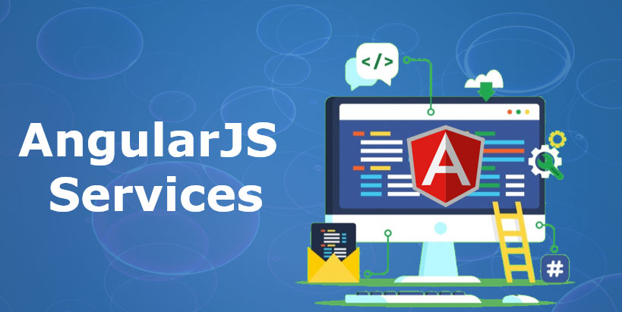
Angular js Services
What are AngularJS Services?
AngularJs service is a function, which can use for the business layer of an application. It is like a constructor function that will invoke only once at runtime with new.
Services in AngularJS are stateless and singleton objects .
Image Source: https://cdn.educba.com/academy/wp-content/uploads/2020/01/angular-js-service.jpg
Notes:
Left (White Color space):
Title - Parent Topic
Subtitle - Subtopic 1
Body Text - Description in bullets
Right (Grey Color Space):
Body Text - Relevant image (with source)/code snippet
Put reference links in Speaker Notes
Reference:
https://www.tutorialspoint.com/internet_technologies/internet_overview.htm/

Slide 82
Angular js Services
When to use Services in AngularJS?
We can use AngularJS services when we want to create things that act as an application interface. It can be used for all those purposes for which constructor is used.
Image Source: https://cdn.educba.com/academy/wp-content/uploads/2020/01/angular-js-service.jpg
Notes:
Left (White Color space):
Title - Parent Topic
Subtitle - Subtopic 1
Body Text - Description in bullets
Right (Grey Color Space):
Body Text - Relevant image (with source)/code snippet
Put reference links in Speaker Notes
Reference:
https://www.tutorialspoint.com/internet_technologies/internet_overview.htm/

Slide 83
Angular js Services
Types of AngularJS Services
There are two types of services in angular:
Built-in services
Custom services
Image Source: https://cdn.educba.com/academy/wp-content/uploads/2020/01/angular-js-service.jpg
Notes:
Left (White Color space):
Title - Parent Topic
Subtitle - Subtopic 1
Body Text - Description in bullets
Right (Grey Color Space):
Body Text - Relevant image (with source)/code snippet
Put reference links in Speaker Notes
Reference:
https://www.tutorialspoint.com/internet_technologies/internet_overview.htm/

Slide 84
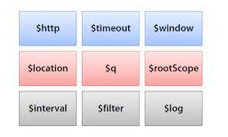
Angular js Services
Built-in Services in AngularJS
They are pre-built services in AngularJS. These services get registered automatically at runtime with the dependency injector.
$http
$interval
$timeout
$anchorscroll
Image Source: https://encrypted-tbn0.gstatic.com/images?q=tbn:ANd9GcQZi-_-a-7v-_r6WA-Ly23zsC8XW51Rww4fLFMnd2w2E8cZdxJ6iUtoxHKHPsdWwVCTXnY&usqp=CAU
Notes:
Left (White Color space):
Title - Parent Topic
Subtitle - Subtopic 1
Body Text - Description in bullets
Right (Grey Color Space):
Body Text - Relevant image (with source)/code snippet
Put reference links in Speaker Notes
Reference:
https://www.tutorialspoint.com/internet_technologies/internet_overview.htm/

Slide 85
Angular js Services
Built-in Services in AngularJS
$animate
$animateCss
$cacheFactory
$templateCache
$compile
$controller
$document:
Image Source: https://encrypted-tbn0.gstatic.com/images?q=tbn:ANd9GcQZi-_-a-7v-_r6WA-Ly23zsC8XW51Rww4fLFMnd2w2E8cZdxJ6iUtoxHKHPsdWwVCTXnY&usqp=CAU
Notes:
Left (White Color space):
Title - Parent Topic
Subtitle - Subtopic 1
Body Text - Description in bullets
Right (Grey Color Space):
Body Text - Relevant image (with source)/code snippet
Put reference links in Speaker Notes
Reference:
https://www.tutorialspoint.com/internet_technologies/internet_overview.htm/

Slide 86
Angular js Services
Built-in Services in AngularJS
$exceptionHandler
$filter
$httpParamSerializer
$httpParamSerializerJQLike
$xhrFactory
$httpBackendx
Image Source: https://encrypted-tbn0.gstatic.com/images?q=tbn:ANd9GcQZi-_-a-7v-_r6WA-Ly23zsC8XW51Rww4fLFMnd2w2E8cZdxJ6iUtoxHKHPsdWwVCTXnY&usqp=CAU
Notes:
Left (White Color space):
Title - Parent Topic
Subtitle - Subtopic 1
Body Text - Description in bullets
Right (Grey Color Space):
Body Text - Relevant image (with source)/code snippet
Put reference links in Speaker Notes
Reference:
https://www.tutorialspoint.com/internet_technologies/internet_overview.htm/

Slide 87
Angular js Services
Built-in Services in AngularJS
$interpolate
$locale
$location
$logiv
$rootElement
$sceDelegate
Image Source: https://encrypted-tbn0.gstatic.com/images?q=tbn:ANd9GcQZi-_-a-7v-_r6WA-Ly23zsC8XW51Rww4fLFMnd2w2E8cZdxJ6iUtoxHKHPsdWwVCTXnY&usqp=CAU
Notes:
Left (White Color space):
Title - Parent Topic
Subtitle - Subtopic 1
Body Text - Description in bullets
Right (Grey Color Space):
Body Text - Relevant image (with source)/code snippet
Put reference links in Speaker Notes
Reference:
https://www.tutorialspoint.com/internet_technologies/internet_overview.htm/

Slide 88
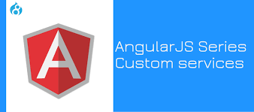
Angular js Services
Customs Services in AngularJS
We can create our own service by connecting it with a module in AngularJS. And to use it add it as a dependency while defining controller.
Image Source: https://www.valuebound.com/sites/default/files/styles/homepage_slider/public/AngularJS%20Series_Custom%20services_Cover%20image.jpg?itok=f7fAw20c
Notes:
Left (White Color space):
Title - Parent Topic
Subtitle - Subtopic 1
Body Text - Description in bullets
Right (Grey Color Space):
Body Text - Relevant image (with source)/code snippet
Put reference links in Speaker Notes
Reference:
https://www.tutorialspoint.com/internet_technologies/internet_overview.htm/

Slide 89
Angular js Http Request
Customs Services in AngularJS
AngularJS provides $http control which works as a service to read data from the server.
$http is an AngularJS service for reading data from remote servers.
Image Source: https://www.valuebound.com/sites/default/files/styles/homepage_slider/public/AngularJS%20Series_Custom%20services_Cover%20image.jpg?itok=f7fAw20c
Notes:
Left (White Color space):
Title - Parent Topic
Subtitle - Subtopic 1
Body Text - Description in bullets
Right (Grey Color Space):
Body Text - Relevant image (with source)/code snippet
Put reference links in Speaker Notes
Reference:
https://www.tutorialspoint.com/internet_technologies/internet_overview.htm/

Slide 90
Angular js Http Request
$http({
method: 'Method_Name',
url: '/someUrl'
}).then(function successCallback(response) {
//when the response is available, this callback will be called asynchronously
}, function errorCallback(response) {
// this method will called when server returns response with an error status.
});
Customs Services in AngularJS
The $http is a core AngularJS service that is used to communicate with the remote HTTP service via browser’s XMLHttpRequest object or via JSONP.
Syntax:
Notes:
Left (White Color space):
Title - Parent Topic
Subtitle - Subtopic 1
Body Text - Description in bullets
Right (Grey Color Space):
Body Text - Relevant image (with source)/code snippet
Put reference links in Speaker Notes
Reference:
https://www.tutorialspoint.com/internet_technologies/internet_overview.htm/

Slide 91
Angular js Http Request
$http({
method: 'Method_Name',
url: '/someUrl'
}).then(function successCallback(response) {
//when the response is available, this callback will be called asynchronously
}, function errorCallback(response) {
// this method will called when server returns response with an error status.
});
Methods
In the above example we used the .get shortcut method for $ajax service . There are also other shortcut methods.
$http.get
$http.post
$http.head
Notes:
Left (White Color space):
Title - Parent Topic
Subtitle - Subtopic 1
Body Text - Description in bullets
Right (Grey Color Space):
Body Text - Relevant image (with source)/code snippet
Put reference links in Speaker Notes
Reference:
https://www.tutorialspoint.com/internet_technologies/internet_overview.htm/

Slide 92
Angular js Http Request
Methods
$http.put
$http.delete
$http.patch
$http.jsonp
Image Source: https://image.slidesharecdn.com/02-httpresource-140216002719-phpapp01/85/angularjs-http-resource-services-6-320.jpg?cb=1392510554
Notes:
Left (White Color space):
Title - Parent Topic
Subtitle - Subtopic 1
Body Text - Description in bullets
Right (Grey Color Space):
Body Text - Relevant image (with source)/code snippet
Put reference links in Speaker Notes
Reference:
https://www.tutorialspoint.com/internet_technologies/internet_overview.htm/

Slide 93
Angular js Http Request
Property | Description
.config | The configuration object that was used to generate the request.
.status | Status number defining the HTTP status.
.data | The response body transformed with the transform functions.
.headers | Function to use to get header information.
.statusText | HTTP status text of the response.
Property
The response from the server is retrieved as an object and this object contains the following properties
Notes:
Left (White Color space):
Title - Parent Topic
Subtitle - Subtopic 1
Body Text - Description in bullets
Right (Grey Color Space):
Body Text - Relevant image (with source)/code snippet
Put reference links in Speaker Notes
Reference:
https://www.tutorialspoint.com/internet_technologies/internet_overview.htm/

Slide 94

Node Introduction
What is Node.js?
Node.js is a server-side platform built on Google Chrome's JavaScript Engine (V8 Engine).
Node.js was developed by Ryan Dahl in 2009 and its latest version is v0.10.36.
Image Source: https://www.tutorialspoint.com/nodejs/images/nodejs_concepts.jpg
Notes:
Left (White Color space):
Title - Parent Topic
Subtitle - Subtopic 1
Body Text - Description in bullets
Right (Grey Color Space):
Body Text - Relevant image (with source)/code snippet
Put reference links in Speaker Notes
Reference:
https://www.tutorialspoint.com/internet_technologies/internet_overview.htm/

Slide 95
Node Introduction
What is Node.js?
Node.js is an open source, cross-platform runtime environment.
Node.js applications are written in JavaScript, and can be run within the Node.js runtime on OS X, Microsoft Windows, and Linux.
Node.js = Runtime Environment + JavaScript Library
Image Source: https://www.tutorialspoint.com/nodejs/images/nodejs_concepts.jpg
Notes:
Left (White Color space):
Title - Parent Topic
Subtitle - Subtopic 1
Body Text - Description in bullets
Right (Grey Color Space):
Body Text - Relevant image (with source)/code snippet
Put reference links in Speaker Notes
Reference:
https://www.tutorialspoint.com/internet_technologies/internet_overview.htm/

Slide 96

Node Introduction
Features of Node.js
Following are some of the important features that make Node.js the first choice of software architects.
Asynchronous and Event Driven
Very Fast
Single Threaded but Highly Scalable
No Buffering
License
Image Source: https://cdn.educba.com/academy/wp-content/uploads/2020/01/Features-of-Node.js-2.png
Notes:
Left (White Color space):
Title - Parent Topic
Subtitle - Subtopic 1
Body Text - Description in bullets
Right (Grey Color Space):
Body Text - Relevant image (with source)/code snippet
Put reference links in Speaker Notes
Reference:
https://www.tutorialspoint.com/internet_technologies/internet_overview.htm/

Slide 97
Node Introduction
Concepts
The following diagram depicts some important parts of Node.js which we will discuss in detail in the subsequent chapters.
Image Source: https://cdn.educba.com/academy/wp-content/uploads/2020/01/Features-of-Node.js-2.png
Notes:
Left (White Color space):
Title - Parent Topic
Subtitle - Subtopic 1
Body Text - Description in bullets
Right (Grey Color Space):
Body Text - Relevant image (with source)/code snippet
Put reference links in Speaker Notes
Reference:
https://www.tutorialspoint.com/internet_technologies/internet_overview.htm/

Slide 98
Node Introduction
HTML Tags and Attributes
The following diagram depicts some important parts of Node.js which we will discuss in detail in the subsequent chapters.
Image Sources: https://www.tutorialspoint.com/nodejs/images/nodejs_concepts.jpg
Notes:
This slide talks about the case if we have to divide a subtopic further.
Title Box - Parent Topic
Subtitle box - Sub Topic
Body Text - Subtopic divisions (Subtopics of subtopics)

Slide 99
Node Introduction
Where to Use Node.js?
Following are the areas where Node.js is proving itself as a perfect technology partner.
I/O bound Applications
Data Streaming Applications
Data Intensive Real-time Applications (DIRT)
JSON APIs based Applications
Single Page Applications
Image Sources: https://www.tutorialspoint.com/nodejs/images/nodejs_concepts.jpg
Notes:
This slide talks about the case if we have to divide a subtopic further.
Title Box - Parent Topic
Subtitle box - Sub Topic
Body Text - Subtopic divisions (Subtopics of subtopics)

Slide 100
Node Introduction
Where Not to Use Node.js?
It is not advisable to use Node.js for CPU intensive applications.
Image Sources: https://www.tutorialspoint.com/nodejs/images/nodejs_concepts.jpg
Notes:
This slide talks about the case if we have to divide a subtopic further.
Title Box - Parent Topic
Subtitle box - Sub Topic
Body Text - Subtopic divisions (Subtopics of subtopics)

Slide 101

Node Introduction
Advantages of NodeJS:
Easy Scalability
Real-time web apps
Fast Suite
Easy to learn and code
Advantage of Caching
Image Sources: https://www.vervelogic.com/blog/wp-content/uploads/2020/03/Advantage-of-nodejs.png
Notes:
This slide talks about the case if we have to divide a subtopic further.
Title Box - Parent Topic
Subtitle box - Sub Topic
Body Text - Subtopic divisions (Subtopics of subtopics)

Slide 102
Node Introduction
Advantages of NodeJS:
Data Streaming
Hosting
Corporate Support
Image Sources: https://www.vervelogic.com/blog/wp-content/uploads/2020/03/Advantage-of-nodejs.png
Notes:
This slide talks about the case if we have to divide a subtopic further.
Title Box - Parent Topic
Subtitle box - Sub Topic
Body Text - Subtopic divisions (Subtopics of subtopics)

Slide 103
Node Introduction
Application of NodeJS
Real-Time Chats,
Complex Single-Page applications,
Real-time collaboration tools,
Streaming apps
JSON APIs based application
Image Sources: https://www.tutorialspoint.com/nodejs/images/nodejs_concepts.jpg
Notes:
This slide talks about the case if we have to divide a subtopic further.
Title Box - Parent Topic
Subtitle box - Sub Topic
Body Text - Subtopic divisions (Subtopics of subtopics)

Slide 104

Blocking & Nonblocking code
Introduction
There are two types of execution of our code, synchronous and asynchronous.
The code is executed in sequence synchronously, and execution is awaited when the function is called.
In asynchronous execution, the line is not necessarily followed, and completion of the operation is not necessary.
Image Sources: https://bytearcher.com/articles/blocking-vs-non-blocking-in-node.js/process_state_diagram01.gif
Notes:
This slide talks about the case if we have to divide a subtopic further.
Title Box - Parent Topic
Subtitle box - Sub Topic
Body Text - Subtopic divisions (Subtopics of subtopics)

Slide 105
Blocking & Nonblocking code
Blocking
It refers to the blocking of further operation until the current operation finishes.
Blocking methods are executed synchronously.
Synchronously means that the program is executed line by line.
The program waits until the called function or the operation returns.
Image Sources: https://bytearcher.com/articles/blocking-vs-non-blocking-in-node.js/process_state_diagram01.gif
Notes:
This slide talks about the case if we have to divide a subtopic further.
Title Box - Parent Topic
Subtitle box - Sub Topic
Body Text - Subtopic divisions (Subtopics of subtopics)

Slide 106

Blocking & Nonblocking code
Non-Blocking
It refers to the program that does not block the execution of further operations. Non-Blocking methods are executed asynchronously.
Asynchronously means that the program may not necessarily execute line by line.
The program calls the function and move to the next operation and does not wait for it to return.
Image Sources: https://bytearcher.com/articles/blocking-vs-non-blocking-in-node.js/process_state_diagram01.gif
Notes:
This slide talks about the case if we have to divide a subtopic further.
Title Box - Parent Topic
Subtitle box - Sub Topic
Body Text - Subtopic divisions (Subtopics of subtopics)

Slide 107

Blocking & Nonblocking code
Comparison between Blocking and Non-Blocking in Node.js
Non-blocking execution is usually faster if we compare blocking and non-blocking code in node.js, allowing concurrency.
It will enable the event loop to execute JavaScript callback functions after completing other operations.
Image Sources: https://bytearcher.com/articles/blocking-vs-non-blocking-in-node.js/process_state_diagram01.gif
Notes:
This slide talks about the case if we have to divide a subtopic further.
Title Box - Parent Topic
Subtitle box - Sub Topic
Body Text - Subtopic divisions (Subtopics of subtopics)

Slide 108
In this section, we will discuss:
Create Module & export, import
Introduction package.json file
File Handling
Create Event Driven Programming
Socket Programming
Create Own web server
Notes:
Mention the parent topics one by one. This particular learning outcome has 4 parent topics.

Slide 109

Node JS
What is the Node JS
Node.js is an open source server environment
Node.js is free
Node.js runs on various platforms (Windows, Linux, Unix, Mac OS X, etc.)
Node.js uses JavaScript on the server
Image Source: https://media.geeksforgeeks.org/wp-content/uploads/20211025202251/UntitledDiagramdrawio2.png
Notes:
Left (White Color space):
Title - Parent Topic
Subtitle - Subtopic 1
Body Text - Description in bullets
Right (Grey Color Space):
Body Text - Relevant image (with source)/code snippet
Put reference links in Speaker Notes
Reference:
https://www.tutorialspoint.com/internet_technologies/internet_overview.htm/

Slide 110
Node JS
What Can Node.js Do?
Node.js can generate dynamic page content
Node.js can create, open, read, write, delete, and close files on the server
Node.js can collect form data
Node.js can add, delete, modify data in your database
Image Source: https://media.geeksforgeeks.org/wp-content/uploads/20211025202251/UntitledDiagramdrawio2.png
Notes:
Left (White Color space):
Title - Parent Topic
Subtitle - Subtopic 1
Body Text - Description in bullets
Right (Grey Color Space):
Body Text - Relevant image (with source)/code snippet
Put reference links in Speaker Notes
Reference:
https://www.tutorialspoint.com/internet_technologies/internet_overview.htm/

Slide 111
Node JS
What is a Node.js File?
Node.js files contain tasks that will be executed on certain events
A typical event is someone trying to access a port on the server
Node.js files must be initiated on the server before having any effect
Node.js files have extension ".js"
Image Source: https://media.geeksforgeeks.org/wp-content/uploads/20211025202251/UntitledDiagramdrawio2.png
Notes:
Left (White Color space):
Title - Parent Topic
Subtitle - Subtopic 1
Body Text - Description in bullets
Right (Grey Color Space):
Body Text - Relevant image (with source)/code snippet
Put reference links in Speaker Notes
Reference:
https://www.tutorialspoint.com/internet_technologies/internet_overview.htm/

Slide 112

Node JS
Import and Export in Node.js
Importing and exporting files are important parts of any programming language. Importing functions or modules enhances the reusability of code. When the application grows in size, maintaining a single file with all the functions and logic becomes difficult. It also hinders the process of debugging. Therefore, it is good practice to create separate files for specific functions and later import them as per requirement.
Image Source: https://miro.medium.com/max/1400/1*weLWZQ7KkJUdXrJeRlTrKg.jpeg
Notes:
Left (White Color space):
Title - Parent Topic
Subtitle - Subtopic 1
Body Text - Description in bullets
Right (Grey Color Space):
Body Text - Relevant image (with source)/code snippet
Put reference links in Speaker Notes
Reference:
https://www.tutorialspoint.com/internet_technologies/internet_overview.htm/

Slide 113
Node JS
Import and Export in Node.js
Node.js also allows importing and exporting functions and modules. Functions in one module can be imported and called in other modules saving the effort to copy function definitions into the other files. The module can be edited or debugged separately making it easier to add or remove features.
Image Source: https://miro.medium.com/max/1400/1*weLWZQ7KkJUdXrJeRlTrKg.jpeg
Notes:
Left (White Color space):
Title - Parent Topic
Subtitle - Subtopic 1
Body Text - Description in bullets
Right (Grey Color Space):
Body Text - Relevant image (with source)/code snippet
Put reference links in Speaker Notes
Reference:
https://www.tutorialspoint.com/internet_technologies/internet_overview.htm/

Slide 114
Node JS
Steps to include functions from other files
Creating a Module
Exporting a Module: Filename: func.js
Importing a Module:
Image Source: https://miro.medium.com/max/1400/1*weLWZQ7KkJUdXrJeRlTrKg.jpeg
Notes:
Left (White Color space):
Title - Parent Topic
Subtitle - Subtopic 1
Body Text - Description in bullets
Right (Grey Color Space):
Body Text - Relevant image (with source)/code snippet
Put reference links in Speaker Notes
Reference:
https://www.tutorialspoint.com/internet_technologies/internet_overview.htm/

Slide 115
Node JS
Creating a Module
Modules are created in Node.js are JavaScript files. Every time a new file with .js extension is created, it becomes a module.
Image Source: https://miro.medium.com/max/1400/1*weLWZQ7KkJUdXrJeRlTrKg.jpeg
Notes:
Left (White Color space):
Title - Parent Topic
Subtitle - Subtopic 1
Body Text - Description in bullets
Right (Grey Color Space):
Body Text - Relevant image (with source)/code snippet
Put reference links in Speaker Notes
Reference:
https://www.tutorialspoint.com/internet_technologies/internet_overview.htm/

Slide 116

Node JS
Exporting a Module: Filename: func.js
function add(x, y) {
return x + y;
}
function subtract(x, y) {
return x - y;
}
// Adding the code below to allow importing
// the functions in other files
module.exports = { add }
Image Source: https://cdn.hashnode.com/res/hashnode/image/upload/v1603082860893/xGgR903x4.png
Notes:
Left (White Color space):
Title - Parent Topic
Subtitle - Subtopic 1
Body Text - Description in bullets
Right (Grey Color Space):
Body Text - Relevant image (with source)/code snippet
Put reference links in Speaker Notes
Reference:
https://www.tutorialspoint.com/internet_technologies/internet_overview.htm/

Slide 117
Node JS
Filename: main.js
// Importing the func.js module
// The ./ says that the func module
// is in the same directory as
// the main.js file
const f = require('./func');
// Require returns an object with add()
// and stores it in the f variable
// which is used to invoke the required
const result = f.add(10, 5);
console.log('The result is:', result);
Output:
The result is: 15
Importing a Module
We need to import the module to use the functions defined in the imported module in another file. The result returned by require() is stored in a variable which is used to invoke the functions using the dot notation.
Notes:
Left (White Color space):
Title - Parent Topic
Subtitle - Subtopic 1
Body Text - Description in bullets
Right (Grey Color Space):
Body Text - Relevant image (with source)/code snippet
Put reference links in Speaker Notes
Reference:
https://www.tutorialspoint.com/internet_technologies/internet_overview.htm/

Slide 118
Node JS
Filename: main.js
const f = require('./func');
console.log(f.add(4, 4));
console.log(f.subtract(8, 4));
Output:
8
4
Importing multiple functions from local file: Filename: func.js
function add(x, y) {
return x + y;
}
function subtract(x, y) {
return x - y;
}
module.exports = { add, subtract};
Notes:
Left (White Color space):
Title - Parent Topic
Subtitle - Subtopic 1
Body Text - Description in bullets
Right (Grey Color Space):
Body Text - Relevant image (with source)/code snippet
Put reference links in Speaker Notes
Reference:
https://www.tutorialspoint.com/internet_technologies/internet_overview.htm/

Slide 119
Node JS
Other ways to export a module
module.exports = {
add: function (x, y) {
return x + y;
},
subtract: function (x, y) {
return x - y;
},
};
Defining the functions inside module.exports object.
Notes:
Left (White Color space):
Title - Parent Topic
Subtitle - Subtopic 1
Body Text - Description in bullets
Right (Grey Color Space):
Body Text - Relevant image (with source)/code snippet
Put reference links in Speaker Notes
Reference:
https://www.tutorialspoint.com/internet_technologies/internet_overview.htm/

Slide 120
Node JS
Other ways to export a module
module.exports.add = function (x, y) {
return x + y;
};
module.exports.subtract = function (x, y) {
return x - y;
};
Defining each function independently as a method of module.exports
Notes:
Left (White Color space):
Title - Parent Topic
Subtitle - Subtopic 1
Body Text - Description in bullets
Right (Grey Color Space):
Body Text - Relevant image (with source)/code snippet
Put reference links in Speaker Notes
Reference:
https://www.tutorialspoint.com/internet_technologies/internet_overview.htm/

Slide 121
Node JS
Other ways to export a module
const lib = require('./mod/lib');
console.log(lib.add(6, 4));
console.log(lib.subtract(12, 4));
Importing a module from a directory:
Importing lib.js file inside the directory, by prefixing lib.js with the directory name.
Notes:
Left (White Color space):
Title - Parent Topic
Subtitle - Subtopic 1
Body Text - Description in bullets
Right (Grey Color Space):
Body Text - Relevant image (with source)/code snippet
Put reference links in Speaker Notes
Reference:
https://www.tutorialspoint.com/internet_technologies/internet_overview.htm/

Slide 122

Node JS
There are three types of modules in Node.js
Importing from local module:
Importing from core modules:
Importing from third party modules:
Image Source: https://reverentgeek.com/content/images/3-ways-to-share-nodejs-modules-across-multiple-projects/3-ways-to-share-nodejs-modules-across-multiple-projects.jpg
Notes:
Left (White Color space):
Title - Parent Topic
Subtitle - Subtopic 1
Body Text - Description in bullets
Right (Grey Color Space):
Body Text - Relevant image (with source)/code snippet
Put reference links in Speaker Notes
Reference:
https://www.tutorialspoint.com/internet_technologies/internet_overview.htm/

Slide 123
Node JS
There are three types of modules in Node.js
Importing from local module: These modules are created by the user and can be imported as:
const var = require('./filename.js'); // OR const var = require('./path/filename.js');
Image Source: https://reverentgeek.com/content/images/3-ways-to-share-nodejs-modules-across-multiple-projects/3-ways-to-share-nodejs-modules-across-multiple-projects.jpg
Notes:
Left (White Color space):
Title - Parent Topic
Subtitle - Subtopic 1
Body Text - Description in bullets
Right (Grey Color Space):
Body Text - Relevant image (with source)/code snippet
Put reference links in Speaker Notes
Reference:
https://www.tutorialspoint.com/internet_technologies/internet_overview.htm/

Slide 124
Node JS
There are three types of modules in Node.js
Importing from core modules: These modules are inbuilt in Node.js and can be imported as:
const var = require('fs');
Image Source: https://reverentgeek.com/content/images/3-ways-to-share-nodejs-modules-across-multiple-projects/3-ways-to-share-nodejs-modules-across-multiple-projects.jpg
Notes:
Left (White Color space):
Title - Parent Topic
Subtitle - Subtopic 1
Body Text - Description in bullets
Right (Grey Color Space):
Body Text - Relevant image (with source)/code snippet
Put reference links in Speaker Notes
Reference:
https://www.tutorialspoint.com/internet_technologies/internet_overview.htm/

Slide 125
Node JS
There are three types of modules in Node.js
Importing from third party modules: These modules are installed using a package manager such as npm. Examples of third party modules are express, mongoose, nodemon, etc. These are imported as:
const express = require('express');
Image Source: https://reverentgeek.com/content/images/3-ways-to-share-nodejs-modules-across-multiple-projects/3-ways-to-share-nodejs-modules-across-multiple-projects.jpg
Notes:
Left (White Color space):
Title - Parent Topic
Subtitle - Subtopic 1
Body Text - Description in bullets
Right (Grey Color Space):
Body Text - Relevant image (with source)/code snippet
Put reference links in Speaker Notes
Reference:
https://www.tutorialspoint.com/internet_technologies/internet_overview.htm/

Slide 126

Node JS
Introduction package.json file
The package.json file is the heart of Node.js system. It is the manifest file of any Node.js project and contains the metadata of the project. The package.json file is the essential part to understand, learn and work with the Node.js. It is the first step to learn about development in Node.js.
Image Source: https://media-exp1.licdn.com/dms/image/C4E0DAQEkv_Z0B0NsDQ/learning-public-crop_288_512/0/1568669708190?e=2147483647&v=beta&t=HBztHgW9LhTcwsskwRwnevmN3WS0Q-FQFXTPspKe8Wg
Notes:
Left (White Color space):
Title - Parent Topic
Subtitle - Subtopic 1
Body Text - Description in bullets
Right (Grey Color Space):
Body Text - Relevant image (with source)/code snippet
Put reference links in Speaker Notes
Reference:
https://www.tutorialspoint.com/internet_technologies/internet_overview.htm/

Slide 127
Node JS
What does package.json file consist of?
The metadata information in package.json file can be categorized into below categories:
1. Identifying metadata properties: It basically consist of the properties to identify the module/project such as the name of the project, current version of the module, license, author of the project, description about the project etc.
Image Source: https://media-exp1.licdn.com/dms/image/C4E0DAQEkv_Z0B0NsDQ/learning-public-crop_288_512/0/1568669708190?e=2147483647&v=beta&t=HBztHgW9LhTcwsskwRwnevmN3WS0Q-FQFXTPspKe8Wg
Notes:
Left (White Color space):
Title - Parent Topic
Subtitle - Subtopic 1
Body Text - Description in bullets
Right (Grey Color Space):
Body Text - Relevant image (with source)/code snippet
Put reference links in Speaker Notes
Reference:
https://www.tutorialspoint.com/internet_technologies/internet_overview.htm/

Slide 128
Node JS
What does package.json file consist of?
2. Functional metadata properties: As the name suggests, it consists of the functional values/properties of the project/module such as the entry/starting point of the module, dependencies in project, scripts being used, repository links of Node project etc.
Image Source: https://media-exp1.licdn.com/dms/image/C4E0DAQEkv_Z0B0NsDQ/learning-public-crop_288_512/0/1568669708190?e=2147483647&v=beta&t=HBztHgW9LhTcwsskwRwnevmN3WS0Q-FQFXTPspKe8Wg
Notes:
Left (White Color space):
Title - Parent Topic
Subtitle - Subtopic 1
Body Text - Description in bullets
Right (Grey Color Space):
Body Text - Relevant image (with source)/code snippet
Put reference links in Speaker Notes
Reference:
https://www.tutorialspoint.com/internet_technologies/internet_overview.htm/

Slide 129
Node JS
Creating a package.json file:
A package.json file can be created in two ways:
Using npm init
Writing directly to file
Image Source: https://media-exp1.licdn.com/dms/image/C4E0DAQEkv_Z0B0NsDQ/learning-public-crop_288_512/0/1568669708190?e=2147483647&v=beta&t=HBztHgW9LhTcwsskwRwnevmN3WS0Q-FQFXTPspKe8Wg
Notes:
Left (White Color space):
Title - Parent Topic
Subtitle - Subtopic 1
Body Text - Description in bullets
Right (Grey Color Space):
Body Text - Relevant image (with source)/code snippet
Put reference links in Speaker Notes
Reference:
https://www.tutorialspoint.com/internet_technologies/internet_overview.htm/

Slide 130
Node JS
Creating a package.json file:
Using npm init : Running this command, system expects user to fill the vital information required as discussed above. It provides users with default values which are editable by the user.
Syntax: npm init
Image Source: https://media-exp1.licdn.com/dms/image/C4E0DAQEkv_Z0B0NsDQ/learning-public-crop_288_512/0/1568669708190?e=2147483647&v=beta&t=HBztHgW9LhTcwsskwRwnevmN3WS0Q-FQFXTPspKe8Wg
Notes:
Left (White Color space):
Title - Parent Topic
Subtitle - Subtopic 1
Body Text - Description in bullets
Right (Grey Color Space):
Body Text - Relevant image (with source)/code snippet
Put reference links in Speaker Notes
Reference:
https://www.tutorialspoint.com/internet_technologies/internet_overview.htm/

Slide 131
Node JS
{ "name": " ADIT IBM ",
"version": "1.0.0",
"description": ”ADIT IBM",
"main": "index.js",
"scripts": {
"test": "echo \"Error: no test specified\" && exit 1",
"start": "node start.js",
},
"engines": { "node": ">=7.6.0", "npm": ">=4.1.2" },
"author": " ADIT IBM ",
"license": "ISC",
"dependencies": {
"body-parser": "^1.17.1",
"express": "^4.15.2",
"express-validator": "^3.1.2",
"mongoose": "^4.8.7",
"nodemon": "^1.14.12", },
"devDependencies": {},
"repository": {
"type": "git",
"url": "https://github.com/gfg/gfg.git" //sample git repo url
},
"bugs": { "url": "https://github.com/gfg/gfg/issues" },
"homepage": "https://github.com/gfg/gfg#readme" }
Creating a package.json file:
Writing directly to file : One can directly write into file with all the required information and can include it in the Node project.
Example: A demo package.json file with the required information.
Ref : https://www.geeksforgeeks.org/node-js-package-json/
Image Source: https://media-exp1.licdn.com/dms/image/C4E0DAQEkv_Z0B0NsDQ/learning-public-crop_288_512/0/1568669708190?e=2147483647&v=beta&t=HBztHgW9LhTcwsskwRwnevmN3WS0Q-FQFXTPspKe8Wg
Notes:
Left (White Color space):
Title - Parent Topic
Subtitle - Subtopic 1
Body Text - Description in bullets
Right (Grey Color Space):
Body Text - Relevant image (with source)/code snippet
Put reference links in Speaker Notes
Reference:
https://www.tutorialspoint.com/internet_technologies/internet_overview.htm/

Slide 132

Node JS
File handling in Node.js
The most important functionalities provided by programming languages are Reading and Writing files from the computers. Node.js provides the functionality to read and write files from the computer. Reading and Writing the file in Node.js is done by using one of the coolest Node.js modules called fs module, it is one of the most well-known built-in Node.js modules out there
Image Source: https://www.sohamkamani.com/static/138a5d433cd2c4de04c25012fa45bae2/banner.png
Notes:
Left (White Color space):
Title - Parent Topic
Subtitle - Subtopic 1
Body Text - Description in bullets
Right (Grey Color Space):
Body Text - Relevant image (with source)/code snippet
Put reference links in Speaker Notes
Reference:
https://www.tutorialspoint.com/internet_technologies/internet_overview.htm/

Slide 133
Node JS
// Require the given module
var fs = require('fs');
// Use readFileSync() method
// Store the result (return value) of this
// method in a variable named readMe
// Keep the file in the same folder so
// donot need to specify the complete path
var readMe = fs.readFileSync('readMe.txt', 'utf-8');
// log the content of file stored in
// a variable to screen
console.log(readMe);
Synchronous method to read the file:
To read the file in synchronous mode we use a method in fs module which is readFileSync(). It takes two parameters first is the file name with complete path and the second parameter is the character encoding which is generally ‘utf-8’.
Notes:
Left (White Color space):
Title - Parent Topic
Subtitle - Subtopic 1
Body Text - Description in bullets
Right (Grey Color Space):
Body Text - Relevant image (with source)/code snippet
Put reference links in Speaker Notes
Reference:
https://www.tutorialspoint.com/internet_technologies/internet_overview.htm/

Slide 134

Node JS
Output :
Synchronous method to read the file:
To read the file in synchronous mode we use a method in fs module which is readFileSync(). It takes two parameters first is the file name with complete path and the second parameter is the character encoding which is generally ‘utf-8’.
Notes:
Left (White Color space):
Title - Parent Topic
Subtitle - Subtopic 1
Body Text - Description in bullets
Right (Grey Color Space):
Body Text - Relevant image (with source)/code snippet
Put reference links in Speaker Notes
Reference:
https://www.tutorialspoint.com/internet_technologies/internet_overview.htm/

Slide 135
Node JS
// Require the given module
var fs = require('fs');
// Use readFileSync() method
// Store the result (return value) of this
// method in a variable named readMe
var readMe = fs.readFileSync('readMe.txt', 'utf-8');
// Store the content and read from
// readMe.txt to a file WriteMe.txt
fs.writeFileSync('writeMe.txt', readMe);
Synchronous method to writing into a file:
To write the file in a synchronous mode we use a method in fs module which is writeFileSync(). It takes two parameters first is the file name with the complete path in which content is to be written and the second parameter is the data to be written in the file.
Notes:
Left (White Color space):
Title - Parent Topic
Subtitle - Subtopic 1
Body Text - Description in bullets
Right (Grey Color Space):
Body Text - Relevant image (with source)/code snippet
Put reference links in Speaker Notes
Reference:
https://www.tutorialspoint.com/internet_technologies/internet_overview.htm/

Slide 136
Node JS
Output :
Synchronous method to writing into a file:
To write the file in a synchronous mode we use a method in fs module which is writeFileSync(). It takes two parameters first is the file name with the complete path in which content is to be written and the second parameter is the data to be written in the file.
Notes:
Left (White Color space):
Title - Parent Topic
Subtitle - Subtopic 1
Body Text - Description in bullets
Right (Grey Color Space):
Body Text - Relevant image (with source)/code snippet
Put reference links in Speaker Notes
Reference:
https://www.tutorialspoint.com/internet_technologies/internet_overview.htm/

Slide 137
Node JS
// Require the given module
var fs = require('fs');
// Use readFile() method
fs.readFile('readMe.txt', 'utf-8', function(err, data) {
// Write the data read from readeMe.txt
// to a file writeMe.txt
if( !err )
fs.writeFile('writeMe.txt', data, (err)=>{
if( err ) {
throw err;
}
});
else
throw err;
});
Asynchronous method to read and write from/into a file:
To read/write the file in an asynchronous mode in fs module we use readFile() and writeFile() methods.
Notes:
Left (White Color space):
Title - Parent Topic
Subtitle - Subtopic 1
Body Text - Description in bullets
Right (Grey Color Space):
Body Text - Relevant image (with source)/code snippet
Put reference links in Speaker Notes
Reference:
https://www.tutorialspoint.com/internet_technologies/internet_overview.htm/

Slide 138

Node JS
Asynchronous method to read and write from/into a file:
Output
Notes:
Left (White Color space):
Title - Parent Topic
Subtitle - Subtopic 1
Body Text - Description in bullets
Right (Grey Color Space):
Body Text - Relevant image (with source)/code snippet
Put reference links in Speaker Notes
Reference:
https://www.tutorialspoint.com/internet_technologies/internet_overview.htm/

Slide 139

Node JS
Explain Event-Driven Programming in Node.js
Node.js makes extensive use of events which is one of the reasons behind its speed when compared to other similar technologies. Once we start a Node.js server, it initializes the variables and functions and then listens for the occurrence of an event.
Image Source: https://media.geeksforgeeks.org/wp-content/uploads/20211017211104/EDP1drawio-660x305.png
Notes:
Left (White Color space):
Title - Parent Topic
Subtitle - Subtopic 1
Body Text - Description in bullets
Right (Grey Color Space):
Body Text - Relevant image (with source)/code snippet
Put reference links in Speaker Notes
Reference:
https://www.tutorialspoint.com/internet_technologies/internet_overview.htm/

Slide 140
Node JS
Explain Event-Driven Programming in Node.js
Event-driven programming is used to synchronize the occurrence of multiple events and to make the program as simple as possible. The basic components of an Event-Driven Program are:
A callback function ( called an event handler) is called when an event is triggered.
An event loop that listens for event triggers and calls the corresponding event handler for that event.
Image Source: https://media.geeksforgeeks.org/wp-content/uploads/20211017211104/EDP1drawio-660x305.png
Notes:
Left (White Color space):
Title - Parent Topic
Subtitle - Subtopic 1
Body Text - Description in bullets
Right (Grey Color Space):
Body Text - Relevant image (with source)/code snippet
Put reference links in Speaker Notes
Reference:
https://www.tutorialspoint.com/internet_technologies/internet_overview.htm/

Slide 141
Node JS
Explain Event-Driven Programming in Node.js
Event-Driven Programming Principles:
A suite of functions for handling the events. These can be either blocking or non-blocking, depending on the implementation.
Binding registered functions to events.
When a registered event is received, an event loop polls for new events and calls the matching event handler(s).
Image Source: https://media.geeksforgeeks.org/wp-content/uploads/20211017211104/EDP1drawio-660x305.png
Notes:
Left (White Color space):
Title - Parent Topic
Subtitle - Subtopic 1
Body Text - Description in bullets
Right (Grey Color Space):
Body Text - Relevant image (with source)/code snippet
Put reference links in Speaker Notes
Reference:
https://www.tutorialspoint.com/internet_technologies/internet_overview.htm/

Slide 142
Node JS
Explain Event-Driven Programming in Node.js
Advantages of Event-Driven Programming:
Flexibility: It is easier to alter sections of code as and when required.
Suitability for graphical interfaces: It allows the user to select tools (like radio buttons etc.) directly from the toolbar
Programming simplicity: It supports predictive coding, which improves the programmer’s coding experience.
Image Source: https://media.geeksforgeeks.org/wp-content/uploads/20211017211104/EDP1drawio-660x305.png
Notes:
Left (White Color space):
Title - Parent Topic
Subtitle - Subtopic 1
Body Text - Description in bullets
Right (Grey Color Space):
Body Text - Relevant image (with source)/code snippet
Put reference links in Speaker Notes
Reference:
https://www.tutorialspoint.com/internet_technologies/internet_overview.htm/

Slide 143
Node JS
Explain Event-Driven Programming in Node.js
Advantages of Event-Driven Programming:
Easy to find natural dividing lines: Natural dividing lines for unit testing infrastructure are easy to come by.
A good way to model systems: Useful method for modeling systems that must be asynchronous and reactive.
Image Source: https://media.geeksforgeeks.org/wp-content/uploads/20211017211104/EDP1drawio-660x305.png
Notes:
Left (White Color space):
Title - Parent Topic
Subtitle - Subtopic 1
Body Text - Description in bullets
Right (Grey Color Space):
Body Text - Relevant image (with source)/code snippet
Put reference links in Speaker Notes
Reference:
https://www.tutorialspoint.com/internet_technologies/internet_overview.htm/

Slide 144
Node JS
Explain Event-Driven Programming in Node.js
Advantages of Event-Driven Programming:
Allows for more interactive programs: It enables more interactive programming. Event-driven programming is used in almost all recent GUI apps.
Using hardware interrupts: It can be accomplished via hardware interrupts, lowering the computer’s power consumption.
Image Source: https://media.geeksforgeeks.org/wp-content/uploads/20211017211104/EDP1drawio-660x305.png
Notes:
Left (White Color space):
Title - Parent Topic
Subtitle - Subtopic 1
Body Text - Description in bullets
Right (Grey Color Space):
Body Text - Relevant image (with source)/code snippet
Put reference links in Speaker Notes
Reference:
https://www.tutorialspoint.com/internet_technologies/internet_overview.htm/

Slide 145
Node JS
Explain Event-Driven Programming in Node.js
Advantages of Event-Driven Programming:
Allows sensors and other hardware: It makes it simple for sensors and other hardware to communicate with software.
Image Source: https://media.geeksforgeeks.org/wp-content/uploads/20211017211104/EDP1drawio-660x305.png
Notes:
Left (White Color space):
Title - Parent Topic
Subtitle - Subtopic 1
Body Text - Description in bullets
Right (Grey Color Space):
Body Text - Relevant image (with source)/code snippet
Put reference links in Speaker Notes
Reference:
https://www.tutorialspoint.com/internet_technologies/internet_overview.htm/

Slide 146
Node JS
Explain Event-Driven Programming in Node.js
Disadvantages of Event-Driven Programming:
Complex: Simple programs become unnecessarily complex.
Less logical and obvious: The flow of the program is usually less logical and more obvious
Image Source: https://media.geeksforgeeks.org/wp-content/uploads/20211017211104/EDP1drawio-660x305.png
Notes:
Left (White Color space):
Title - Parent Topic
Subtitle - Subtopic 1
Body Text - Description in bullets
Right (Grey Color Space):
Body Text - Relevant image (with source)/code snippet
Put reference links in Speaker Notes
Reference:
https://www.tutorialspoint.com/internet_technologies/internet_overview.htm/

Slide 147
Node JS
Explain Event-Driven Programming in Node.js
Disadvantages of Event-Driven Programming:
Difficult to find error: Debugging an event-driven program is difficult
Confusing: Too many forms in a program might be confusing and/or frustrating for the programmer.
Image Source: https://media.geeksforgeeks.org/wp-content/uploads/20211017211104/EDP1drawio-660x305.png
Notes:
Left (White Color space):
Title - Parent Topic
Subtitle - Subtopic 1
Body Text - Description in bullets
Right (Grey Color Space):
Body Text - Relevant image (with source)/code snippet
Put reference links in Speaker Notes
Reference:
https://www.tutorialspoint.com/internet_technologies/internet_overview.htm/

Slide 148
Node JS
Explain Event-Driven Programming in Node.js
Disadvantages of Event-Driven Programming:
Tight coupling: The event schema will be tightly coupled with the consumers of the schema.
Blocking: Complex blocking of operations.
Image Source: https://media.geeksforgeeks.org/wp-content/uploads/20211017211104/EDP1drawio-660x305.png
Notes:
Left (White Color space):
Title - Parent Topic
Subtitle - Subtopic 1
Body Text - Description in bullets
Right (Grey Color Space):
Body Text - Relevant image (with source)/code snippet
Put reference links in Speaker Notes
Reference:
https://www.tutorialspoint.com/internet_technologies/internet_overview.htm/

Slide 149

Node JS
What is a Web Socket?
Web Socket is a protocol that provides full-duplex(multiway) communication i.e allows communication in both directions simultaneously. It is a modern web technology in which there is a continuous connection between the user’s browser(client) and the server. In this type of communication, between the web server and the web browser, both of them can send messages to each other at any point in time.
Image Source: https://i.stack.imgur.com/Ydwdx.png
Notes:
Left (White Color space):
Title - Parent Topic
Subtitle - Subtopic 1
Body Text - Description in bullets
Right (Grey Color Space):
Body Text - Relevant image (with source)/code snippet
Put reference links in Speaker Notes
Reference:
https://www.tutorialspoint.com/internet_technologies/internet_overview.htm/

Slide 150
Node JS
What is a Web Socket?
We can simply install it by running the below command in cmd and then add this dependency to your server-side javascript file also install an express module which is basically required for server-side application
npm install socket.io --save
npm install express --save
Image Source: https://i.stack.imgur.com/Ydwdx.png
Notes:
Left (White Color space):
Title - Parent Topic
Subtitle - Subtopic 1
Body Text - Description in bullets
Right (Grey Color Space):
Body Text - Relevant image (with source)/code snippet
Put reference links in Speaker Notes
Reference:
https://www.tutorialspoint.com/internet_technologies/internet_overview.htm/

Slide 151

Node JS
How to Build a Simple Web Server with Node.js ?
Introduction: Node.js is an open-source and cross-platform runtime environment for executing JavaScript code outside a browser. You need to remember that NodeJS is not a framework, and it’s not a programming language. Node.js is mostly used in server-side programming. In this article, we will discuss how to make a web server using node.js.
Image Source: https://www.guru99.com/images/NodeJS/010716_0600_NodejsHttpT2.png
Notes:
Left (White Color space):
Title - Parent Topic
Subtitle - Subtopic 1
Body Text - Description in bullets
Right (Grey Color Space):
Body Text - Relevant image (with source)/code snippet
Put reference links in Speaker Notes
Reference:
https://www.tutorialspoint.com/internet_technologies/internet_overview.htm/

Slide 152
Node JS
How to Build a Simple Web Server with Node.js ?
Creating Web Servers Using NodeJS: There are mainly two ways as follows.
Using http inbuilt module
Using express third party module
Image Source: https://www.guru99.com/images/NodeJS/010716_0600_NodejsHttpT2.png
Notes:
Left (White Color space):
Title - Parent Topic
Subtitle - Subtopic 1
Body Text - Description in bullets
Right (Grey Color Space):
Body Text - Relevant image (with source)/code snippet
Put reference links in Speaker Notes
Reference:
https://www.tutorialspoint.com/internet_technologies/internet_overview.htm/

Slide 153
Node JS
How to Build a Simple Web Server with Node.js ?
Using http module: HTTP and HTTPS, these two inbuilt modules are used to create a simple server. The HTTPS module provides the feature of the encryption of communication with the help of the secure layer feature of this module. Whereas the HTTP module doesn’t provide the encryption of the data.
Image Source: https://www.guru99.com/images/NodeJS/010716_0600_NodejsHttpT2.png
Notes:
Left (White Color space):
Title - Parent Topic
Subtitle - Subtopic 1
Body Text - Description in bullets
Right (Grey Color Space):
Body Text - Relevant image (with source)/code snippet
Put reference links in Speaker Notes
Reference:
https://www.tutorialspoint.com/internet_technologies/internet_overview.htm/

Slide 154
Node JS
How to Build a Simple Web Server with Node.js ?
Using express module: The express.js is one of the most powerful frameworks of the node.js that works on the upper layer of the http module. The main advantage of using express.js server is filtering the incoming requests by clients.
Installing module: Install the required module using the following command.
npm install express
Image Source: https://www.guru99.com/images/NodeJS/010716_0600_NodejsHttpT2.png
Notes:
Left (White Color space):
Title - Parent Topic
Subtitle - Subtopic 1
Body Text - Description in bullets
Right (Grey Color Space):
Body Text - Relevant image (with source)/code snippet
Put reference links in Speaker Notes
Reference:
https://www.tutorialspoint.com/internet_technologies/internet_overview.htm/

Slide 155
In this section, we will discuss:
Create Web App using express
Introduction Middleware Concepts
Express Routing
Express JS Template Engine
Handling Query string parameter
Cookies parser & body parser,
Session Handling (express session), Mailer
Database operation with MySQL
Notes:
Mention the parent topics one by one. This particular learning outcome has 4 parent topics.

Slide 156

Create Web App using express
Express Overview
Express is a minimal and flexible Node.js web application framework that provides a robust set of features to develop web and mobile applications.
It facilitates the rapid development of Node based Web applications.
Image Source: https://medium.com/@ralph1786/how-to-setup-an-express-server-5fd9cd9ae073
Notes:
Left (White Color space):
Title - Parent Topic
Subtitle - Subtopic 1
Body Text - Description in bullets
Right (Grey Color Space):
Body Text - Relevant image (with source)/code snippet
Put reference links in Speaker Notes
Reference:
https://www.tutorialspoint.com/internet_technologies/internet_overview.htm/

Slide 157
Create Web App using express
Core features of Express framework
Allows to set up middlewares to respond to HTTP Requests.
Defines a routing table which is used to perform different actions based on HTTP Method and URL.
Allows to dynamically render HTML Pages based on passing arguments to templates.
Image Source: https://medium.com/@ralph1786/how-to-setup-an-express-server-5fd9cd9ae073
Notes:
Left (White Color space):
Title - Parent Topic
Subtitle - Subtopic 1
Body Text - Description in bullets
Right (Grey Color Space):
Body Text - Relevant image (with source)/code snippet
Put reference links in Speaker Notes
Reference:
https://www.tutorialspoint.com/internet_technologies/internet_overview.htm/

Slide 158
Create Web App using express
Installing Express
$ npm install express –save
The above command saves the installation locally in the node_modules directory and creates a directory express inside node_modules.
Image Source: https://medium.com/@ralph1786/how-to-setup-an-express-server-5fd9cd9ae073
Notes:
Left (White Color space):
Title - Parent Topic
Subtitle - Subtopic 1
Body Text - Description in bullets
Right (Grey Color Space):
Body Text - Relevant image (with source)/code snippet
Put reference links in Speaker Notes
Reference:
https://www.tutorialspoint.com/internet_technologies/internet_overview.htm/

Slide 159

Introduction to Middleware Concepts
ExpressJS – Middleware
Middleware functions are functions that have access to the request object (req), the response object (res), and the next middleware function in the application’s request-response cycle.
These functions are used to modify req and res objects for tasks like parsing request bodies, adding response headers, etc.
Image Source: https://www.tutorialspoint.com/expressjs/expressjs_middleware.htm
Notes:
Left (White Color space):
Title - Parent Topic
Subtitle - Subtopic 1
Body Text - Description in bullets
Right (Grey Color Space):
Body Text - Relevant image (with source)/code snippet
Put reference links in Speaker Notes
Reference:
https://www.tutorialspoint.com/internet_technologies/internet_overview.htm/

Slide 160

Express Routing
ExpressJS – Routing
Web frameworks provide resources such as HTML pages, scripts, images, etc. at different routes.
The following function is used to define routes in an Express application −
app.method(path, handler)
Image Source: https://www.dotnettricks.com/learn/nodejs/expressjs-routes-routing
Notes:
Left (White Color space):
Title - Parent Topic
Subtitle - Subtopic 1
Body Text - Description in bullets
Right (Grey Color Space):
Body Text - Relevant image (with source)/code snippet
Put reference links in Speaker Notes
Reference:
https://www.tutorialspoint.com/internet_technologies/internet_overview.htm/

Slide 161

Express JS Template Engine
ExpressJS – Templating
Pug is a templating engine for Express.
Templating engines are used to remove the cluttering of our server code with HTML, concatenating strings wildly to existing HTML templates.
Image Source: https://medium.com/@carmelagreco/quick-generation-of-a-new-node-js-project-using-express-express-generator-and-pug-f8e9cf6b2687
Notes:
Left (White Color space):
Title - Parent Topic
Subtitle - Subtopic 1
Body Text - Description in bullets
Right (Grey Color Space):
Body Text - Relevant image (with source)/code snippet
Put reference links in Speaker Notes
Reference:
https://www.tutorialspoint.com/internet_technologies/internet_overview.htm/

Slide 162
Express JS Template Engine
ExpressJS – Templating
To use Pug with Express, we need to install it,
npm install --save pug
Now that Pug is installed, set it as the templating engine for your app.
Image Source: https://medium.com/@carmelagreco/quick-generation-of-a-new-node-js-project-using-express-express-generator-and-pug-f8e9cf6b2687
Notes:
Left (White Color space):
Title - Parent Topic
Subtitle - Subtopic 1
Body Text - Description in bullets
Right (Grey Color Space):
Body Text - Relevant image (with source)/code snippet
Put reference links in Speaker Notes
Reference:
https://www.tutorialspoint.com/internet_technologies/internet_overview.htm/

Slide 163
Express JS Template Engine
ExpressJS – Templating
Important Features of Pug
Simple Tags
Space separated
Piped text
Block of text
Image Source: https://medium.com/@carmelagreco/quick-generation-of-a-new-node-js-project-using-express-express-generator-and-pug-f8e9cf6b2687
Notes:
Left (White Color space):
Title - Parent Topic
Subtitle - Subtopic 1
Body Text - Description in bullets
Right (Grey Color Space):
Body Text - Relevant image (with source)/code snippet
Put reference links in Speaker Notes
Reference:
https://www.tutorialspoint.com/internet_technologies/internet_overview.htm/

Slide 164
Handling Query string parameter
ExpressJS – URL Building
We can now define routes, but those are static or fixed. To use the dynamic routes, we SHOULD provide different types of routes.
Using dynamic routes allows us to pass parameters and process based on them.
Image Source: https://medium.com/@ralph1786/how-to-setup-an-express-server-5fd9cd9ae073
Notes:
Left (White Color space):
Title - Parent Topic
Subtitle - Subtopic 1
Body Text - Description in bullets
Right (Grey Color Space):
Body Text - Relevant image (with source)/code snippet
Put reference links in Speaker Notes
Reference:
https://www.tutorialspoint.com/internet_technologies/internet_overview.htm/

Slide 165

Cookies parser & body parser
ExpressJS – Cookies
Cookies are simple, small files/data that are sent to client with a server request and stored on the client side.
Every time the user loads the website back, this cookie is sent with the request.
This helps us keep track of the user’s actions.
Image Source: https://www.w3jar.com/node-express-js-cookies/
Notes:
Left (White Color space):
Title - Parent Topic
Subtitle - Subtopic 1
Body Text - Description in bullets
Right (Grey Color Space):
Body Text - Relevant image (with source)/code snippet
Put reference links in Speaker Notes
Reference:
https://www.tutorialspoint.com/internet_technologies/internet_overview.htm/

Slide 166
Cookies parser & body parser
ExpressJS – Cookies
The following are the numerous uses of the HTTP Cookies −
Session management
Personalization(Recommendation systems)
User tracking
Image Source: https://www.w3jar.com/node-express-js-cookies/
Notes:
Left (White Color space):
Title - Parent Topic
Subtitle - Subtopic 1
Body Text - Description in bullets
Right (Grey Color Space):
Body Text - Relevant image (with source)/code snippet
Put reference links in Speaker Notes
Reference:
https://www.tutorialspoint.com/internet_technologies/internet_overview.htm/

Slide 167
Cookies parser & body parser
ExpressJS – Body-parser
Body-parser is the Node.js body parsing middleware.
It is responsible for parsing the incoming request bodies in a middleware before you handle it.
Image Source: https://medium.com/@ralph1786/how-to-setup-an-express-server-5fd9cd9ae073
Notes:
Left (White Color space):
Title - Parent Topic
Subtitle - Subtopic 1
Body Text - Description in bullets
Right (Grey Color Space):
Body Text - Relevant image (with source)/code snippet
Put reference links in Speaker Notes
Reference:
https://www.tutorialspoint.com/internet_technologies/internet_overview.htm/

Slide 168

Session Handling (express session), Mailer
ExpressJS – Sessions
Sessions assign the client an ID and it makes all further requests using that ID.
Information associated with the client is stored on the server linked to this ID.
Image Source: https://www.section.io/engineering-education/session-management-in-nodejs-using-expressjs-and-express-session/
Notes:
Left (White Color space):
Title - Parent Topic
Subtitle - Subtopic 1
Body Text - Description in bullets
Right (Grey Color Space):
Body Text - Relevant image (with source)/code snippet
Put reference links in Speaker Notes
Reference:
https://www.tutorialspoint.com/internet_technologies/internet_overview.htm/

Slide 169
Session Handling (express session), Mailer
ExpressJS – mailer
Express Mailer extends your express application
Works with Express 3.x.x
Install by the following command:
$ npm install express-mailer
Image Source: https://medium.com/@ralph1786/how-to-setup-an-express-server-5fd9cd9ae073
Notes:
Left (White Color space):
Title - Parent Topic
Subtitle - Subtopic 1
Body Text - Description in bullets
Right (Grey Color Space):
Body Text - Relevant image (with source)/code snippet
Put reference links in Speaker Notes
Reference:
https://www.tutorialspoint.com/internet_technologies/internet_overview.htm/

Slide 170

Database operation with MySQL
Setup Express js for Node.js MySQL
To set up express, we will use the express-generator.
You can generate an express js app without any view engine with the following command:
npx express-generator --no-view --git nodejs-mysql
Image Source: https://levelup.gitconnected.com/bulk-operation-into-mysql-with-nodejs-478c8fc30917
Notes:
Left (White Color space):
Title - Parent Topic
Subtitle - Subtopic 1
Body Text - Description in bullets
Right (Grey Color Space):
Body Text - Relevant image (with source)/code snippet
Put reference links in Speaker Notes
Reference:
https://www.tutorialspoint.com/internet_technologies/internet_overview.htm/

Slide 171
Database operation with MySQL
MySQL Installation
The following command will install MySQL
$ npm install mysql
Image Source: https://levelup.gitconnected.com/bulk-operation-into-mysql-with-nodejs-478c8fc30917
Notes:
Left (White Color space):
Title - Parent Topic
Subtitle - Subtopic 1
Body Text - Description in bullets
Right (Grey Color Space):
Body Text - Relevant image (with source)/code snippet
Put reference links in Speaker Notes
Reference:
https://www.tutorialspoint.com/internet_technologies/internet_overview.htm/

Slide 172


MongoDB

Slide 173
In this section, we will discuss:
Introduction to MongoDB
Features of MongoDB
Create database, collection, Document & Data
Simple Query, Insert select data, filter data
Capped collection, Update & delete Collection
Index and Relationship, Aggregation & grouping, JOIN
Import & export mongo database, Backup restore
database operation with Node +Mongodb

Slide 174

Introduction to MongoDB
Definition
MongoDB is an open-source, cross-platform, and distributed document-based database designed for ease of application development and scaling.
Image Source: https://tinyurl.com/2v4ya3a2

Slide 175


Introduction to MongoDB
Relation between MongoDB and RDBMS
Image Source: https://tinyurl.com/ycy9psst

Slide 176
Features of MongoDB
Features
Support ad hoc queries
Indexing
Replication
Load balancing
Supports map reduce and aggregation tools.
Uses JavaScript instead of Procedures.
Provides high performance.
Stores files of any size easily without complicating your stack.

Slide 177
Create database, collection, Document & Data
Database
Database is a physical container for collections.
Each database gets its own set of files on the file system.
A single MongoDB server typically has multiple databases

Slide 178
Create database, collection, Document & Data
Database
To create a new database:
use DATABASE_NAME
To check currently selected database:db
To check databases list: show dbs

Slide 179
Create database, collection, Document & Data
Field | Type | Description
capped | Boolean | (Optional) If true, enables a capped collection. Capped collection is a fixed size collection that automatically overwrites its oldest entries when it reaches its maximum size. If you specify true, you need to specify size parameter also.
autoIndexId | Boolean | (Optional) If true, automatically create index on _id field.s Default value is false.
size | number | (Optional) Specifies a maximum size in bytes for a capped collection. If capped is true, then you need to specify this field also.
max | number | (Optional) Specifies the maximum number of documents allowed in the capped collection.
Collection
Collection is a group of MongoDB documents.
It is the equivalent of an RDBMS table.
A collection exists within a single database.
Collections do not enforce a schema.
Documents within a collection can have different fields.
Syntax:
db.createCollection(name, options)
name is name of collection to be created. Options is a document and is used to specify configuration of collection.

Slide 180

Create database, collection, Document & Data
Document
A document is a set of key-value pairs.
Documents have dynamic schema.
Dynamic schema means that documents in the same collection do not need to have the same set of fields or structure, and common fields in a collection's documents may hold different types of data.
Image Source: https://www.tutorialsteacher.com/Content/images/mongodb/document.png

Slide 181

Create database, Collection, Document & Data
Document
insertOne(): to insert a single document in a collection.
db.collection.insertOne(document, [writeConcern])
Where,
document: A document to insert into the collection.
writeConcern (Optional): A document expressing the writeConcern to override the default write concern.

Slide 182

Create database, Collection, Document & Data
Document
insertMany():
To insert a multiple document in a collection.
db.collection.insertMany()
I

Slide 183
Capped collection, Update & delete Collection
Capped Collection
Fixed-size circular collections that follow the insertion order to support high performance for create, read, and delete operations.
Capped collections restrict updates to the documents if the update results in increased document size.
I

Slide 184
Capped collection, Update & delete Collection
Capped Collection
To create a capped collection:
db.createCollection("cappedLogCollection",{capped:true,size:10000})
To collection size, limit the number of documents in the collection using the max parameter
db.createCollection("cappedLogCollection",{capped:true,size:10000,max:1000})
I

Slide 185
Capped collection, Update & delete Collection
Update Collection
db.collection.updateOne(filter, document, options)
db.collection.updateMany(filter, document, options)
Parameters:
filter: The selection criteria for the update, same as find() method.
document: A document or pipeline that contains modifications to apply.
options: Optional. May contains options for update behavior. It includes upsert, writeConcern, collation, etc.
I

Slide 186
Capped collection, Update & delete Collection
Delete Collection
db.collection.deleteOne(filter, options)
db.collection.deleteMany(filter, options)
Parameters:
filter: The selection criteria for the update, same as find() method.
options: Optional. May contains options for update behavior. It includes writeConcern, collation, and hint parameters.
I

Slide 187

Index and Relationship, Aggregation & grouping, JOIN
Index
Indexes support the efficient resolution of queries.
Indexes are special data structures, that store a small portion of the data set in an easy-to-traverse form.
The index stores the value of a specific field or set of fields, ordered by the value of the field as specified in the index.
I

Slide 188
Index and Relationship, Aggregation & grouping, JOIN
Index
The basic syntax of createIndex() method is : db.COLLECTION_NAME.createIndex({KEY:1})
To create index on multiple fields.
db.mycol.createIndex({"title":1,"description":-1})
I

Slide 189


Index and Relationship, Aggregation & grouping, JOIN
Relationship
User Document
Relationships in MongoDB represent how various documents are logically related to each other.
Relationships can be modeled via Embedded and Referenced approaches.
Such relationships can be either 1:1, 1:N, N:1 or N:N.
I
Address Document

Slide 190


Index and Relationship, Aggregation & grouping, JOIN
Relationship
In the embedded approach, the address document will embed inside the user document.
In Modeling Referenced Relationships both the user and address documents will be maintained separately but the user document will contain a field that will reference the address document's id field.
Modeling Embedded Relationships
I
Modeling Referenced Relationships

Slide 191


Index and Relationship, Aggregation & grouping, JOIN
Aggregation & grouping
Aggregations operations process data records and return computed results
Aggregation operations group values from multiple documents together, and can perform a variety of operations on the grouped data to return a single result.
In SQL count(*) and with group by is an equivalent of MongoDB aggregation.
db.COLLECTION_NAME.aggregate(AGGREGATE_OPERATION)
I

Slide 192



Index and Relationship, Aggregation & grouping, JOIN
JOIN
MongoDB is not a relational database, but but a left outer join can be perform by using the $lookup stage.
The $lookup stage lets specify which collection you want to join with the current collection, and which fields that should match.
db.COLLECTION_NAME.aggregate(AGGREGATE_OPERATION)
I

Slide 193
Import & export mongo database, Backup restore
Import & export , Backup restore
mongoexport: Being used to export data from a Collection to a file (json, csv,..)
mongoimport: Being used to import data to a Collection from a file (json, csv,..)
mongodump: Being used to export all datas of a database to files (Put in a folder), including some files (bson, json)
mongostore: Being used to import all datas to a database from dump directory (Product of mongodump)
I

Slide 194

Database operation with Node + Mongodb
Creating a database
To create a database in MongoDB, start by creating a MongoClient object, then specify a connection URL with the correct ip address and the name of the database MongoDB will create the database if it does not exist, and make a connection to it.
I

Slide 195

Database operation with Node + Mongodb
Creating a collection
A collection in MongoDB is the same as a table in MySQL.
To create a collection in MongoDB, use the createCollection() method:

Slide 196

Database operation with Node + Mongodb
Insert Into Collection
A document in MongoDB is the same as a record in MySQL.
insertOne() method:
The first parameter of the insertOne() method is an object containing the name(s) and value(s) of each field in the document to be insert.

Slide 197

Database operation with Node + Mongodb
Delete Document
deleteOne() method
The first parameter of the deleteOne() method is a query object defining which document to delete.
If the query finds more than one document, only the first occurrence is deleted.

Slide 198

Database operation with Node + Mongodb
Update Document
updateOne() method
The first parameter of the updateOne() method is a query object defining which document to update. The second parameter is an object defining the new values of the document.
If the query finds more than one record, only the first occurrence is updated.

Slide 199
Database operation with Node + Mongodb
Update Document
updateOne() method
The first parameter of the updateOne() method is a query object defining which document to update. The second parameter is an object defining the new values of the document.
If the query finds more than one record, only the first occurrence is updated.

Slide 200
Thank You

